Slide 1
TST12188 RNAseq study of SMN2 splice-modulator lead compounds
Zhen Gao
10/10/2023

Slide 2
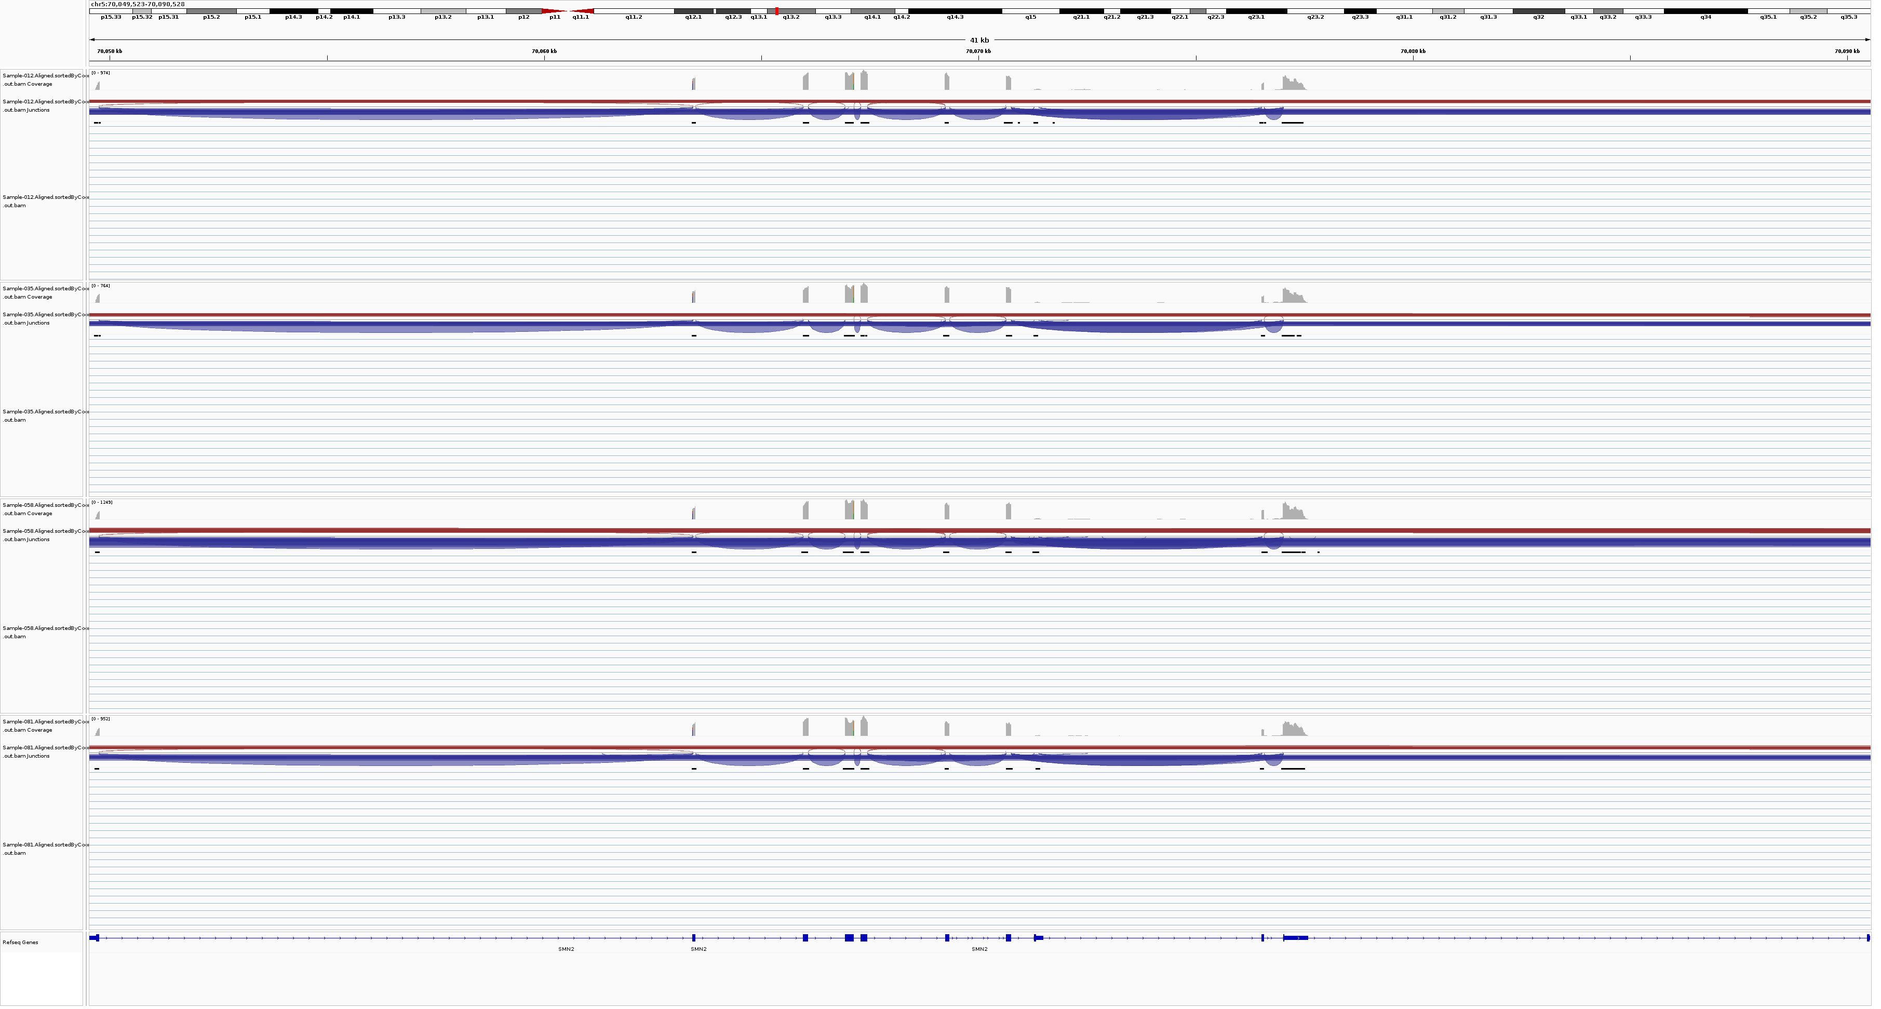
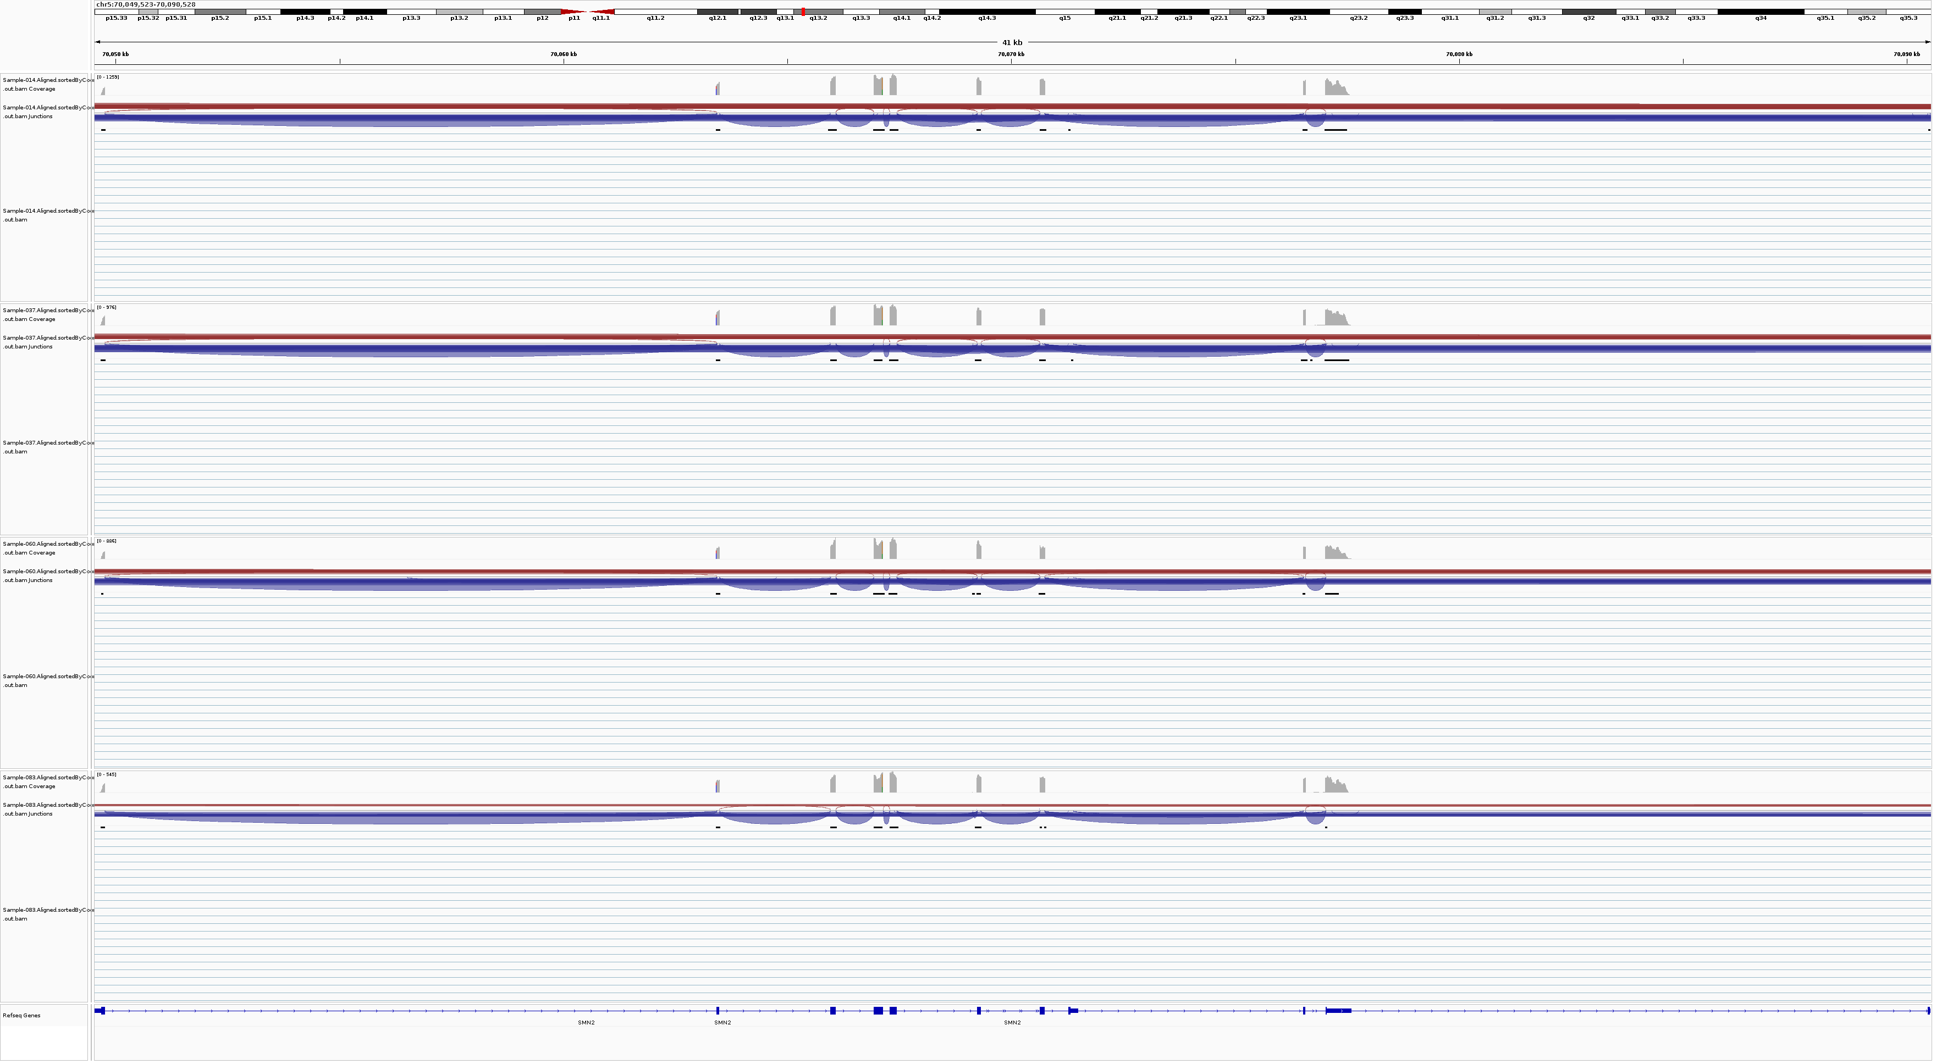
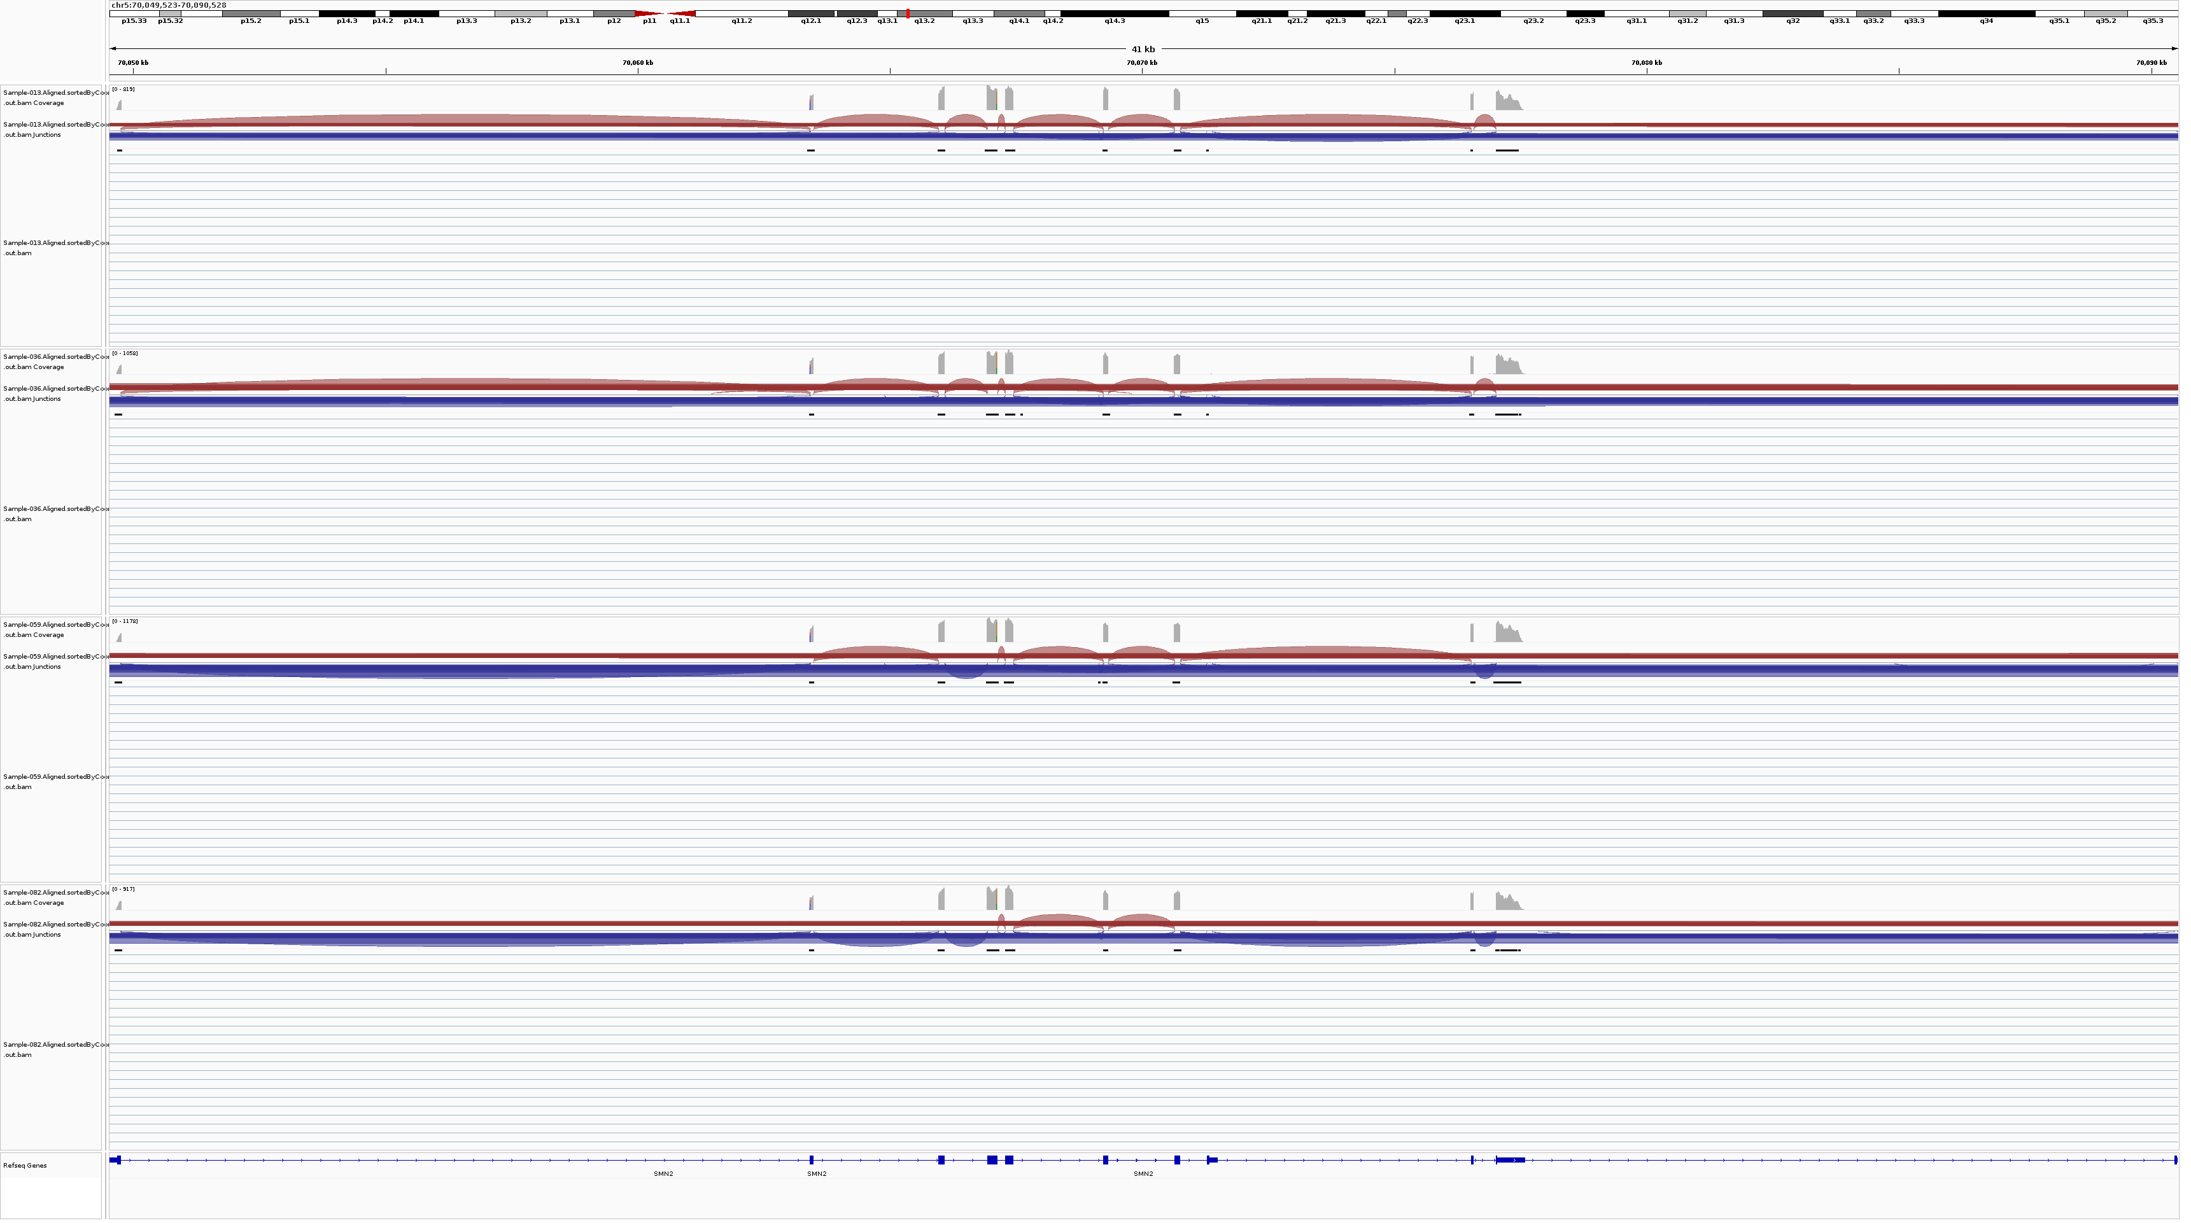
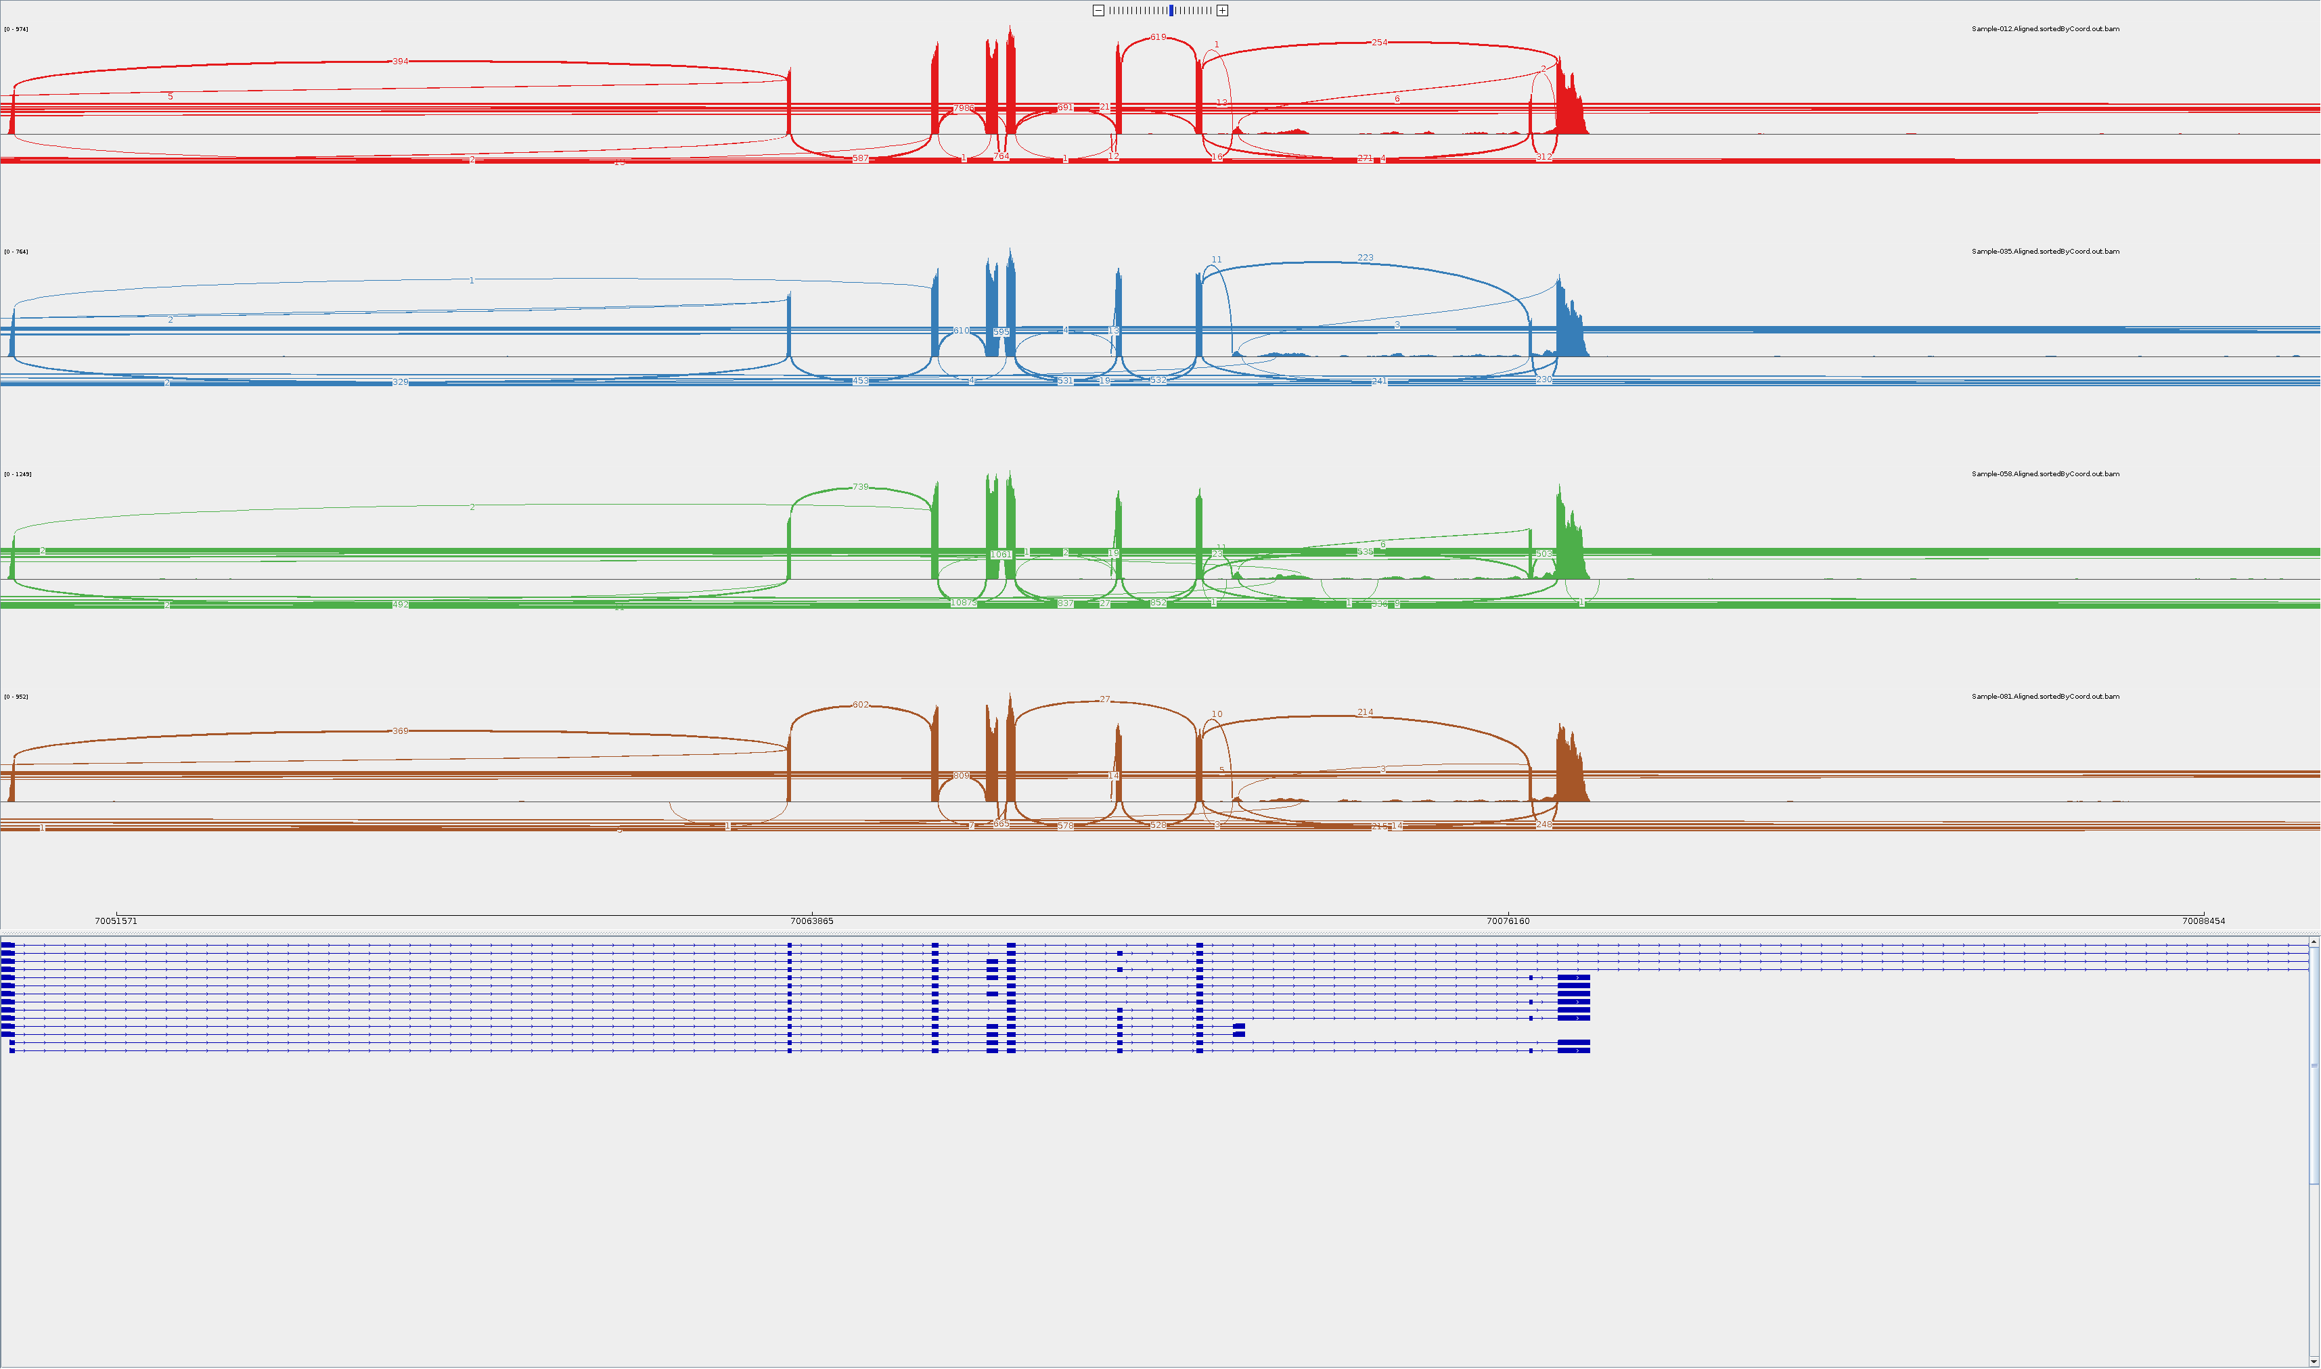
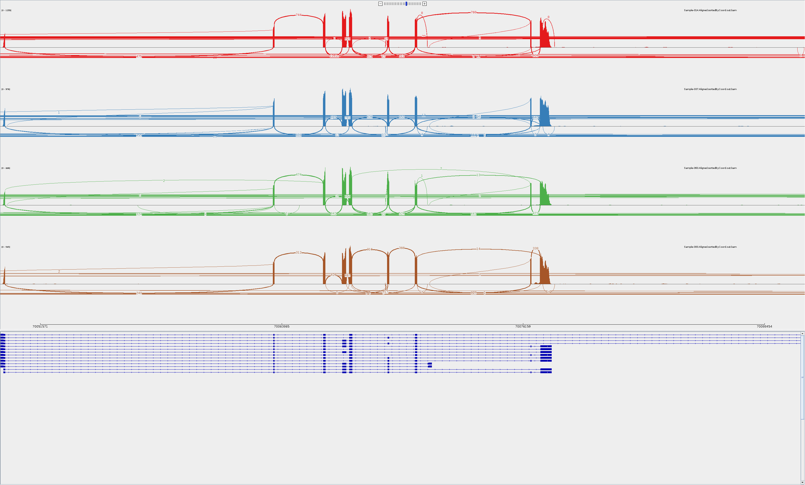
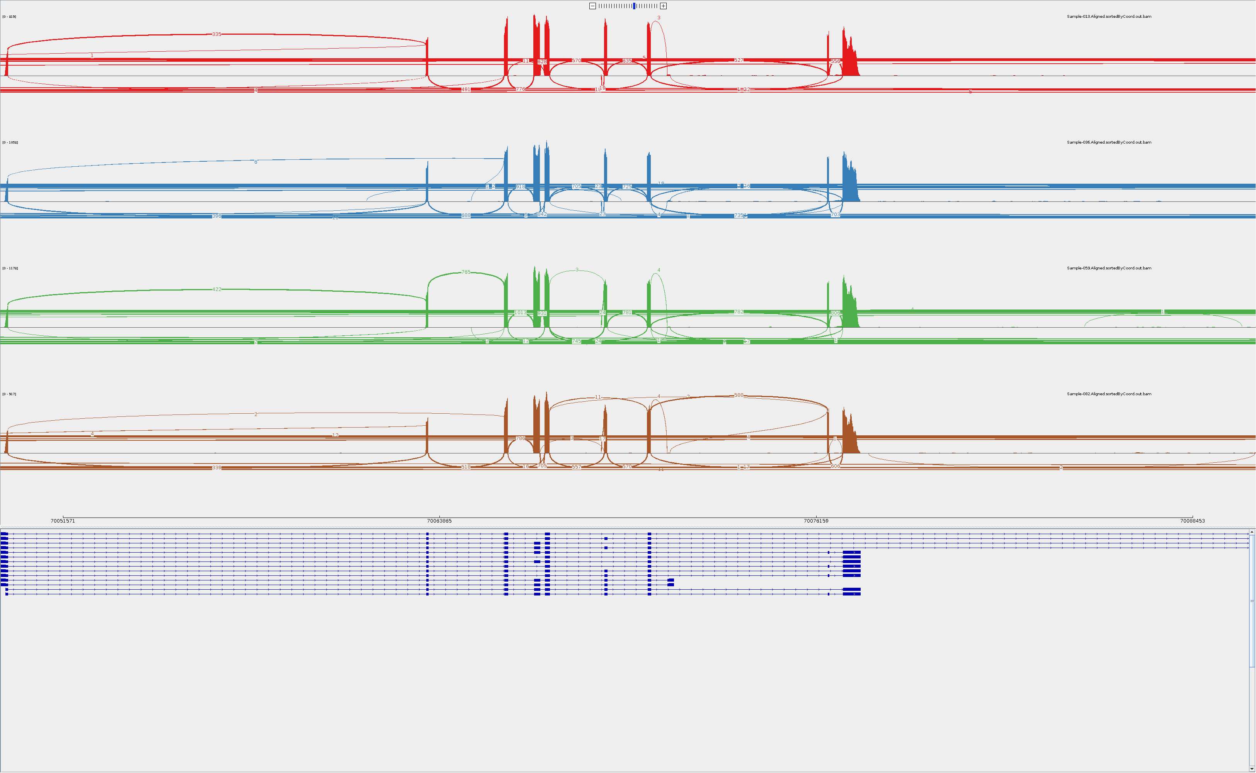
GM09677c SMA fibroblasts SMN2
DMSO
Risdiplam
Compound-6772

Slide 3
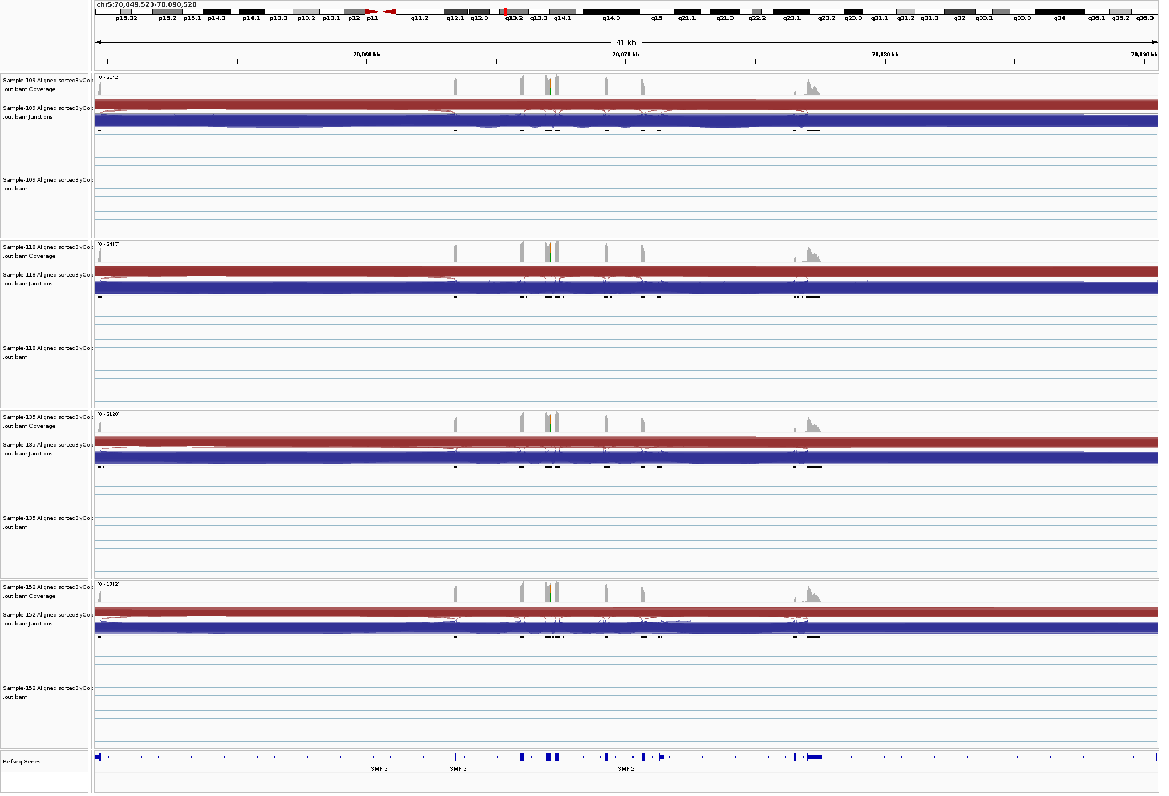
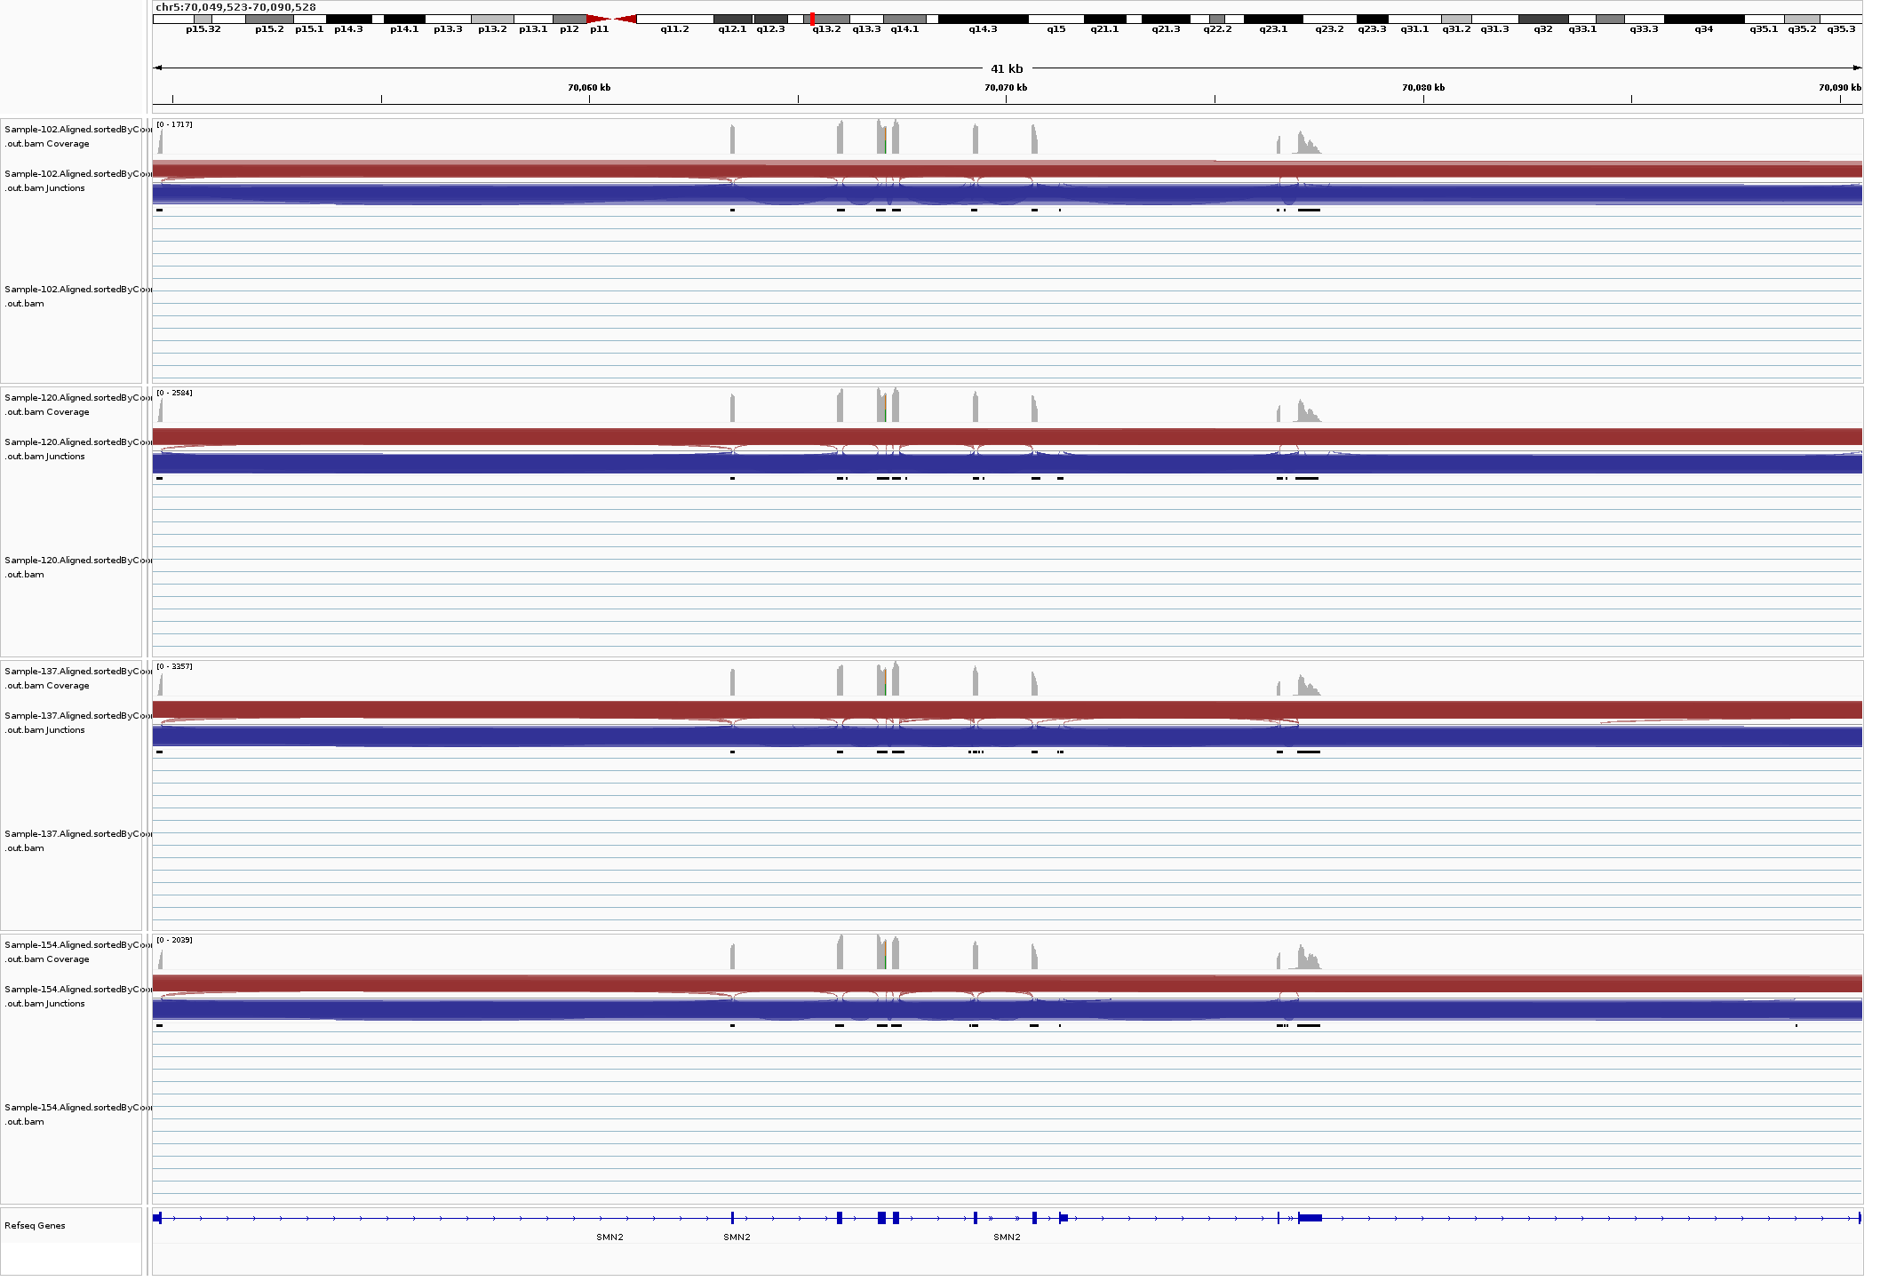
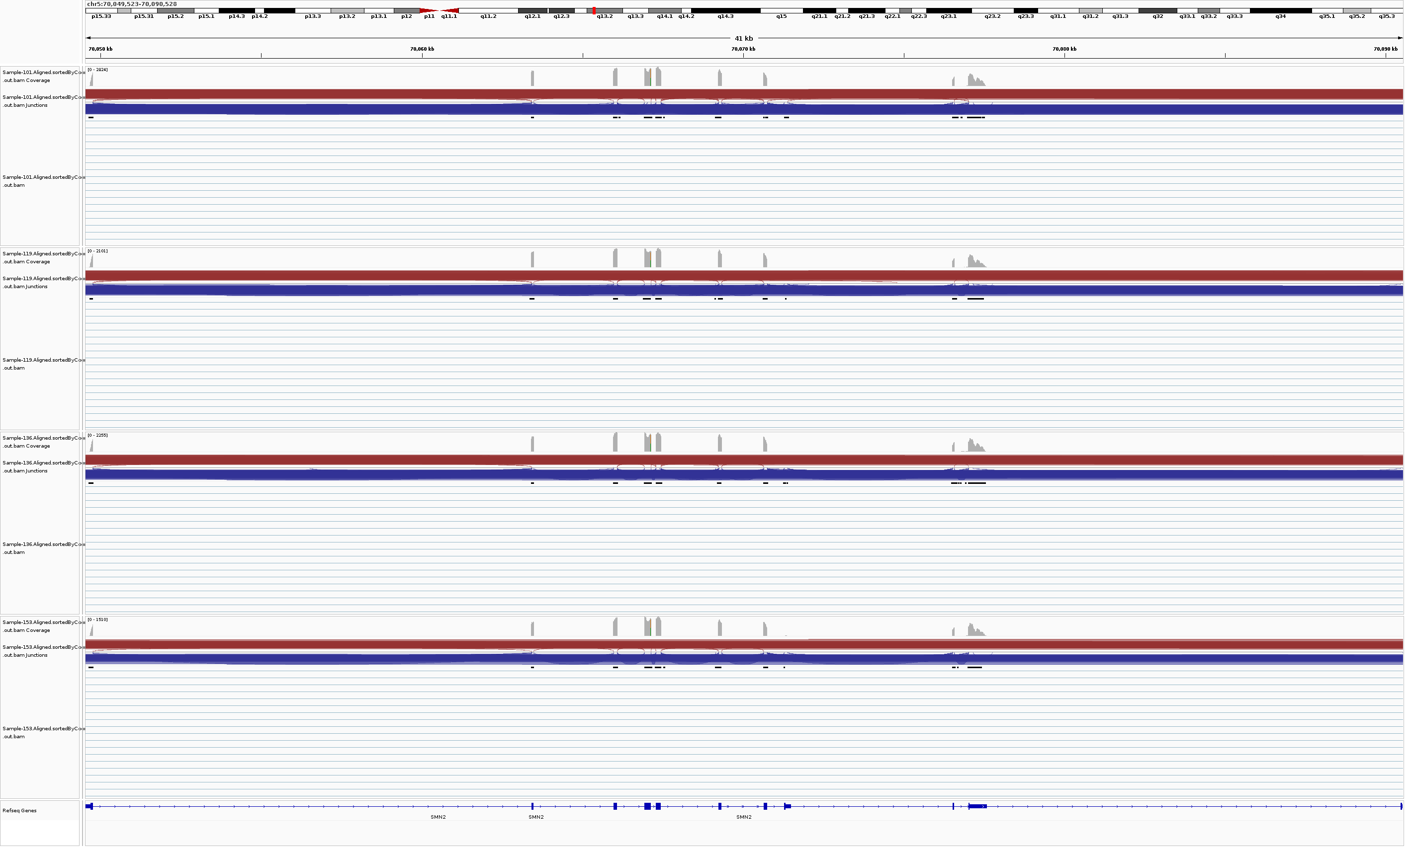
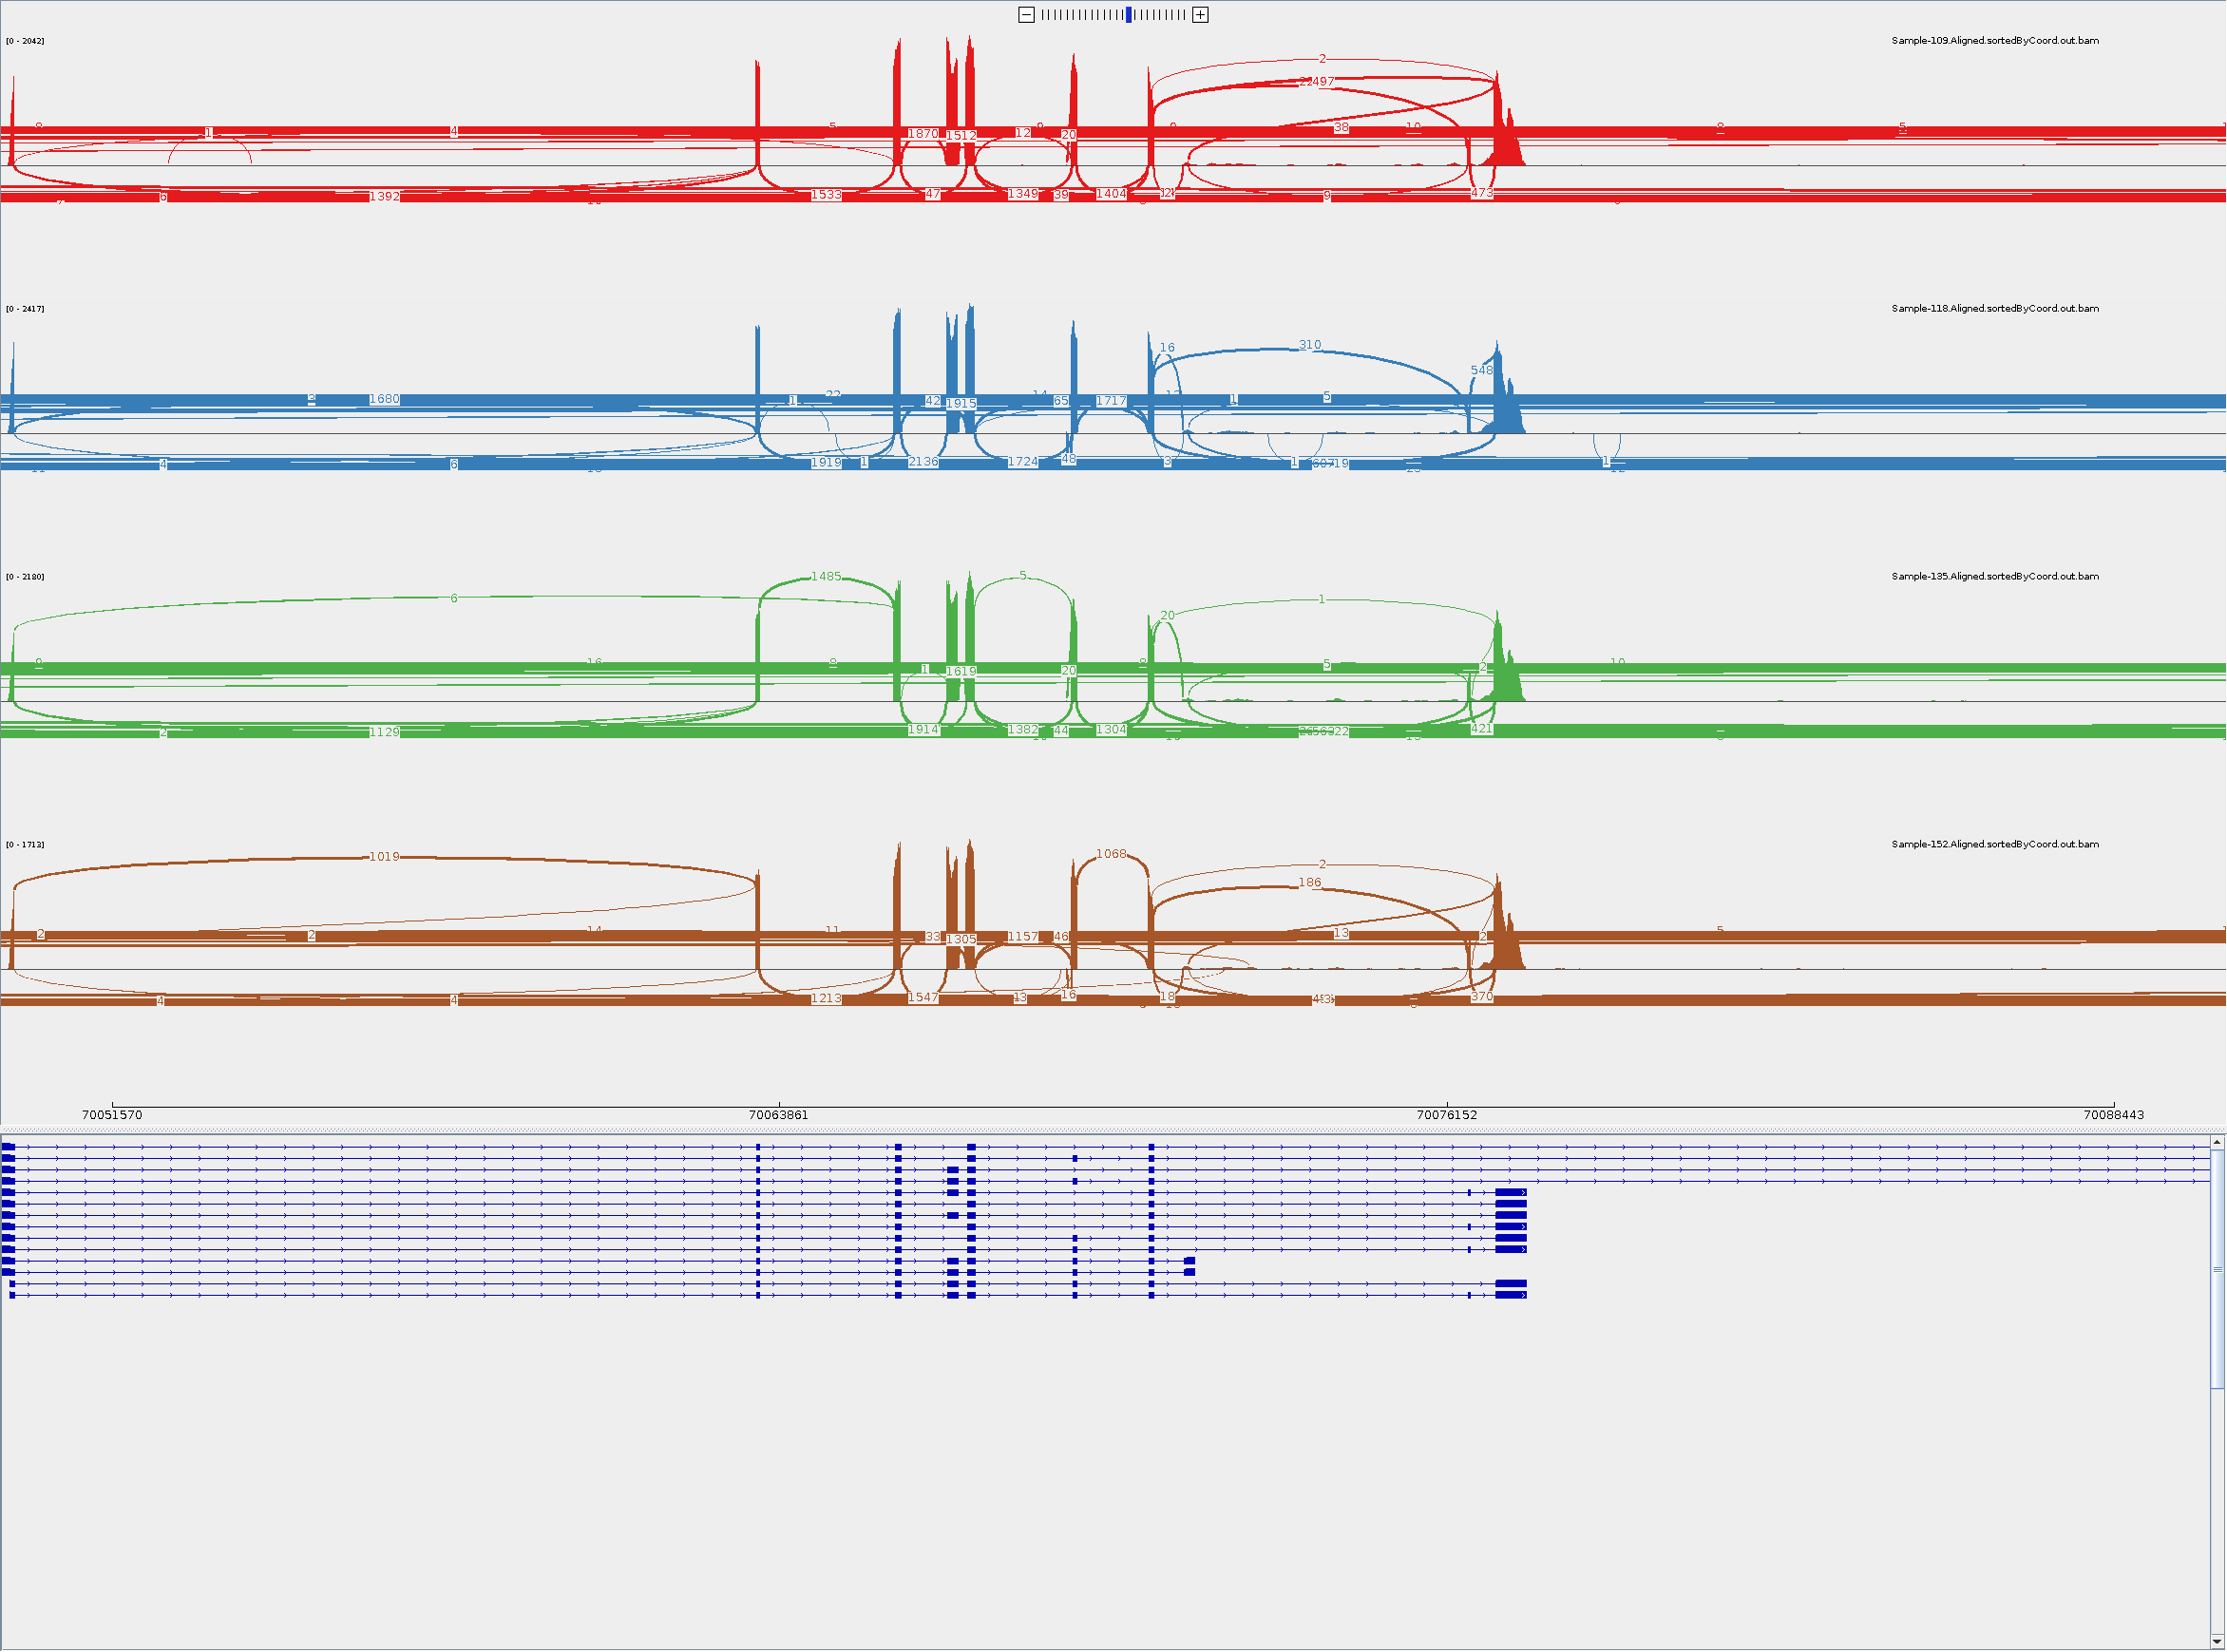
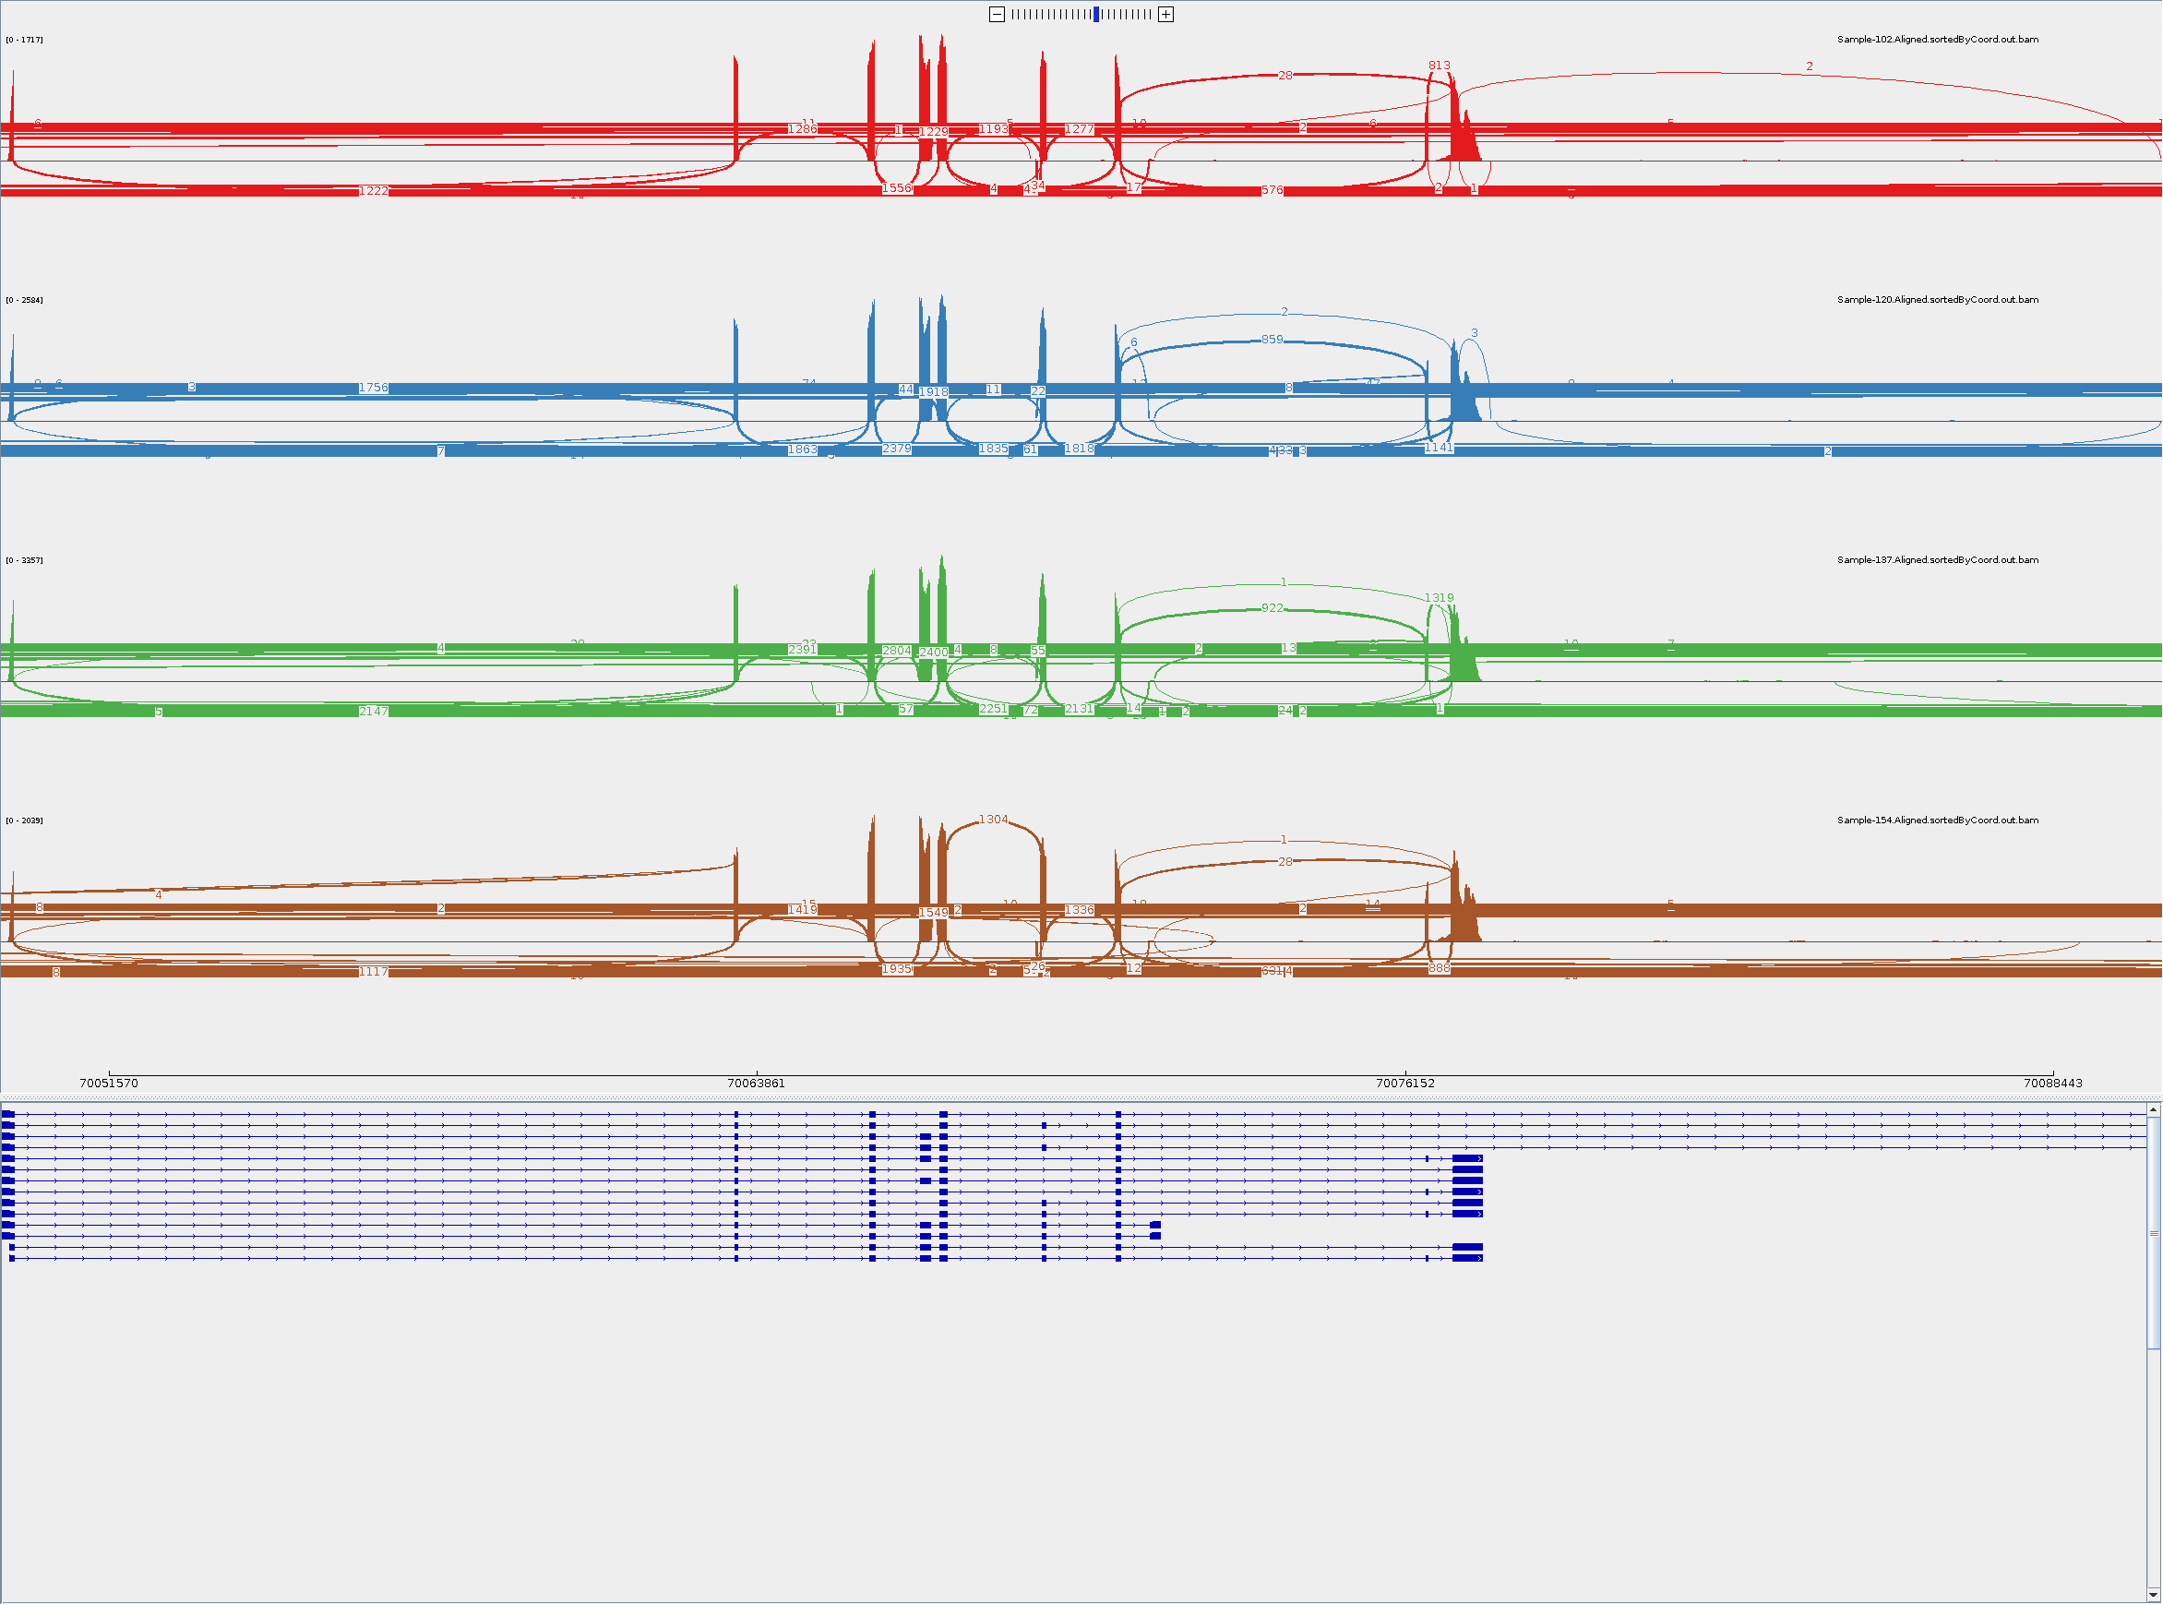
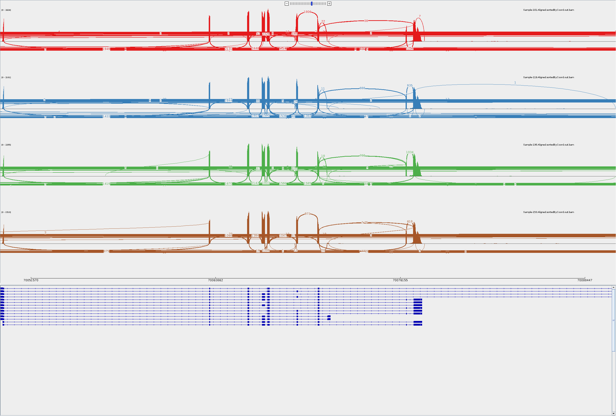
ShSy5y SMN2
DMSO
Risdiplam
Compound-6772

Slide 4
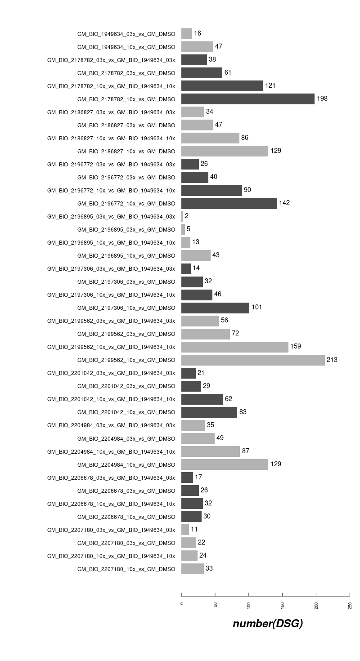

DSG Counts in GM09677c SMA fibroblasts off-Targets (10 compounds and risdiplam)
4vs4
3vs3

Slide 5
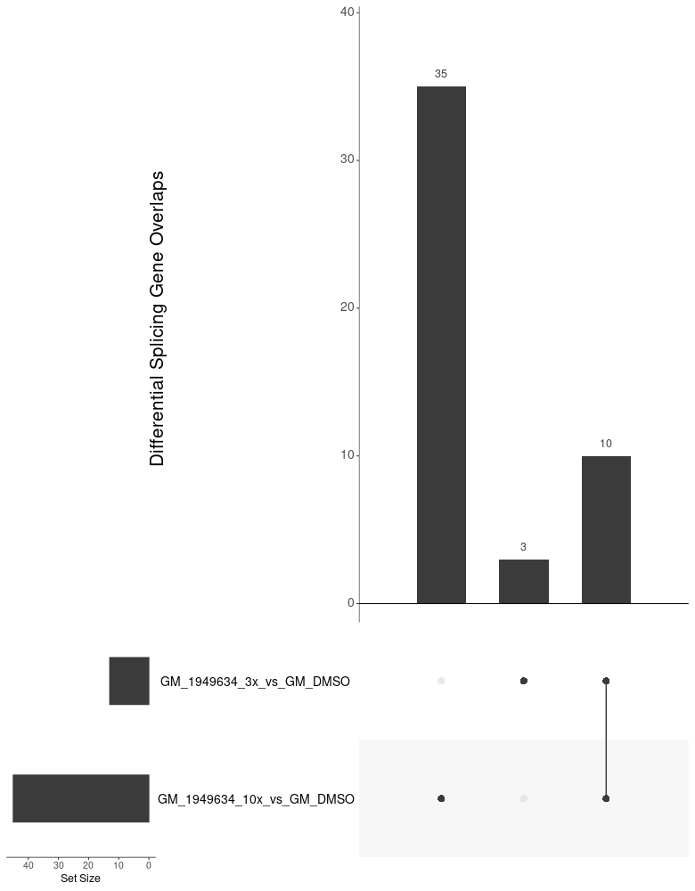
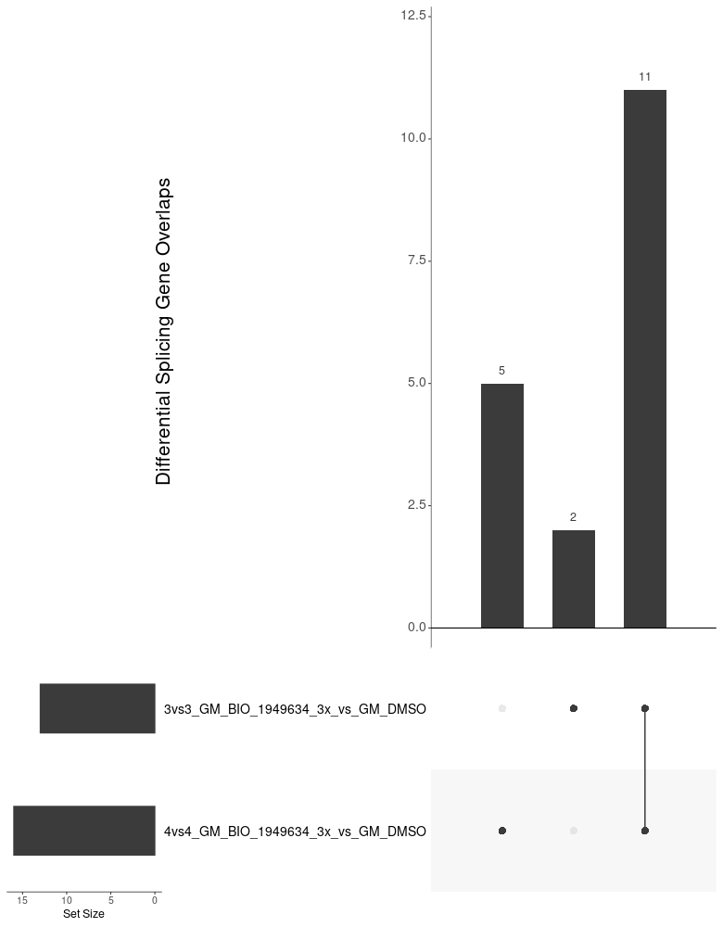
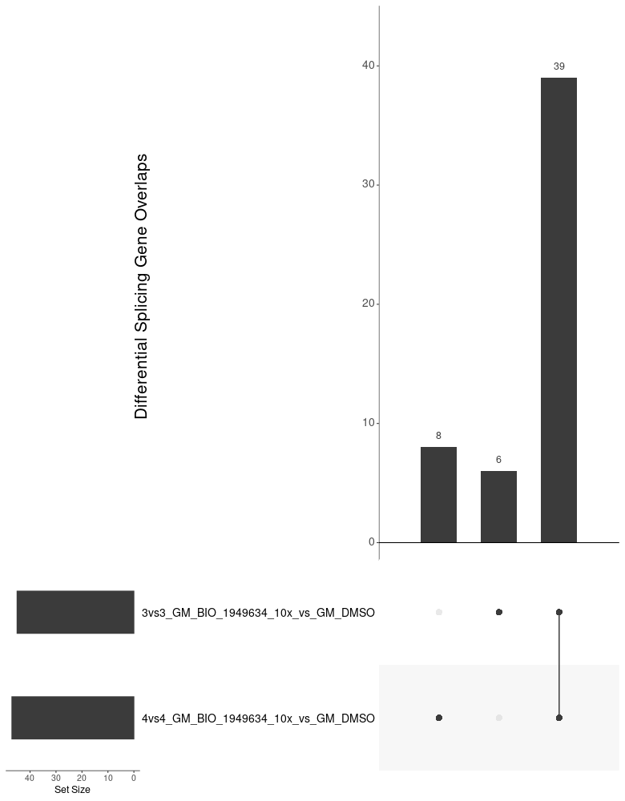
Overview of Compounds in GM09677c off-Targets overlap in risdiplam (within 3vs3 setting and cross 3vs3/4vs4 setting)
10/13 DSG induced by 3x Risdiplam were
Covered by 10x Risdiplam in 3vs3 setting
Most DSG induced by 3x Risdiplam
Are consistent across 3vs3 and 4vs4 setting
Super majority of the DSG induced by 10x Risdiplam
Are consistent across 3vs3 and 4vs4 setting

Slide 6
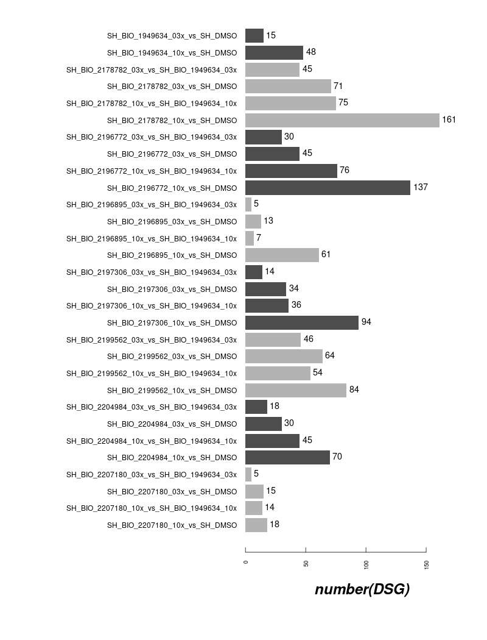
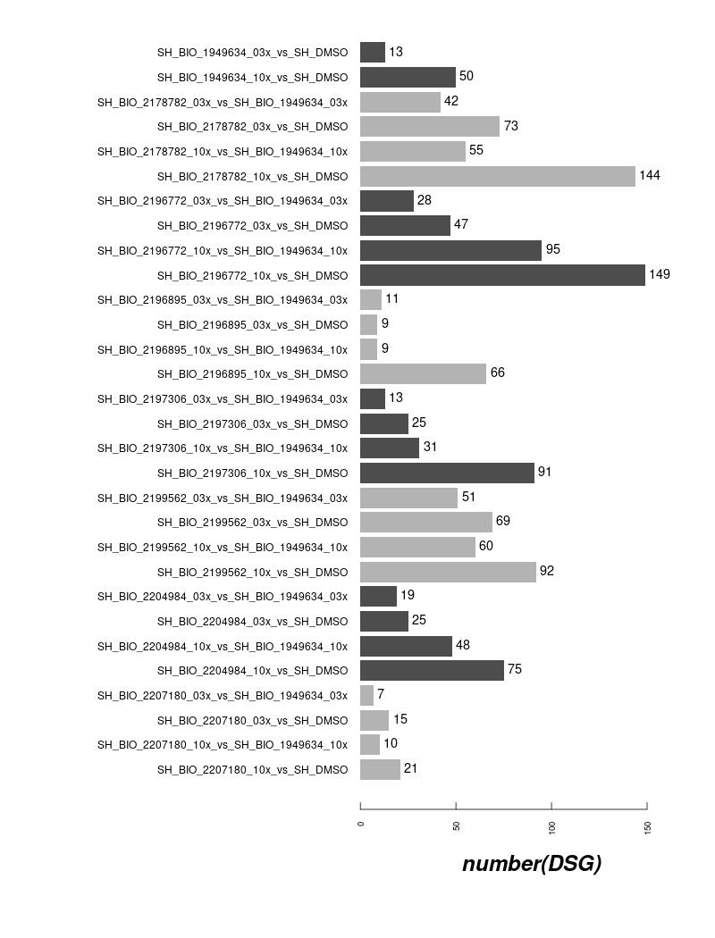
DSG Counts in ShSy5Y off-Targets (7 compounds and risdiplam)
4vs4
3vs3

Slide 7
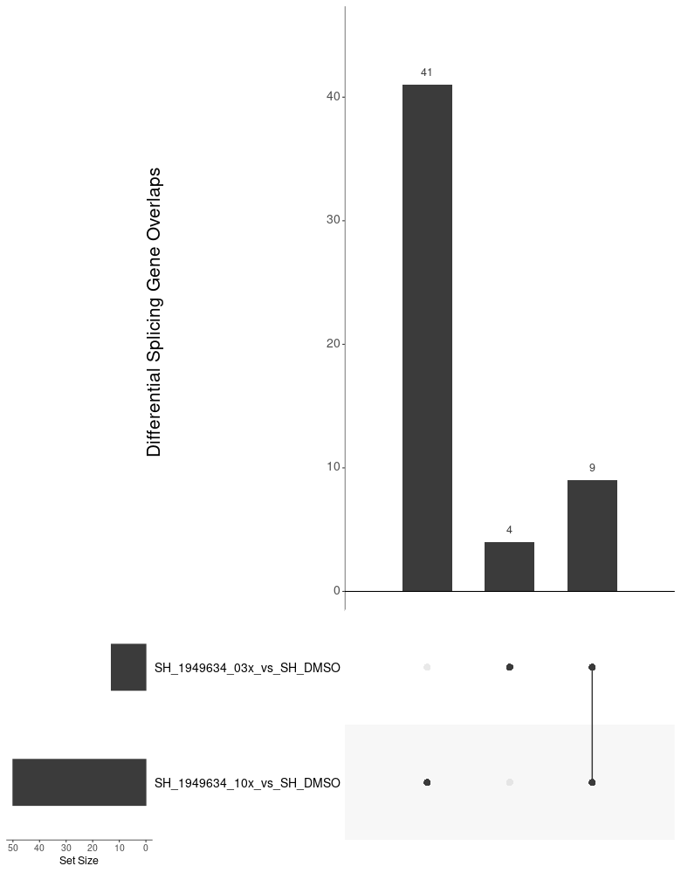
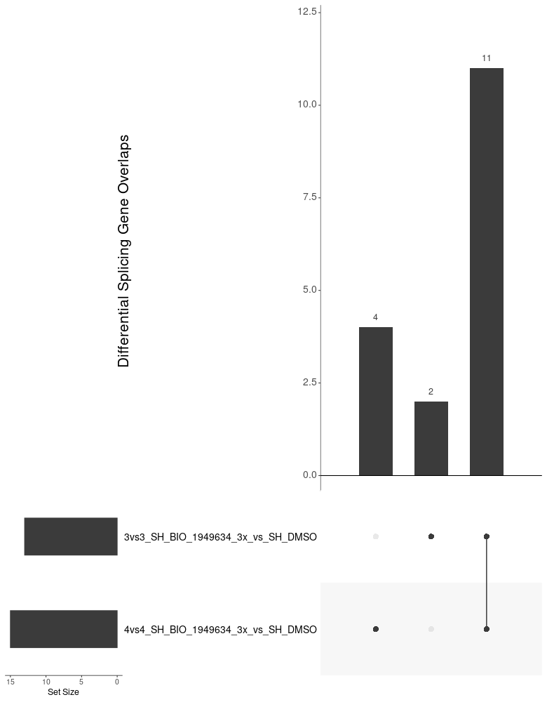

Overview of Compounds in ShSy5Y off-Targets overlap in risdiplam (within 3vs3 setting and cross 3vs3/4vs4 setting)
9/13 DSG induced by 3x Risdiplam were
Covered by 10x Risdiplam in 3vs3 setting
Most DSG induced by 3x Risdiplam
Are consistent across 3vs3 and 4vs4 setting
Super majority of the DSG induced by 10x Risdiplam
Are consistent across 3vs3 and 4vs4 setting

Slide 8
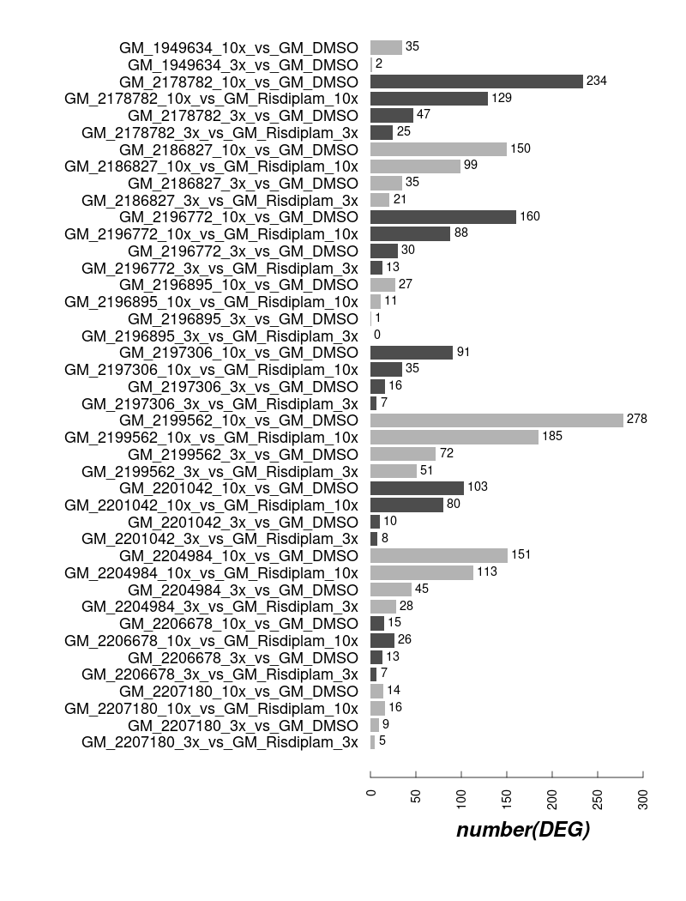

DEG Counts in GM09677c SMA fibroblasts off-Targets (10 compounds and risdiplam)
4vs4
3vs3

Slide 9
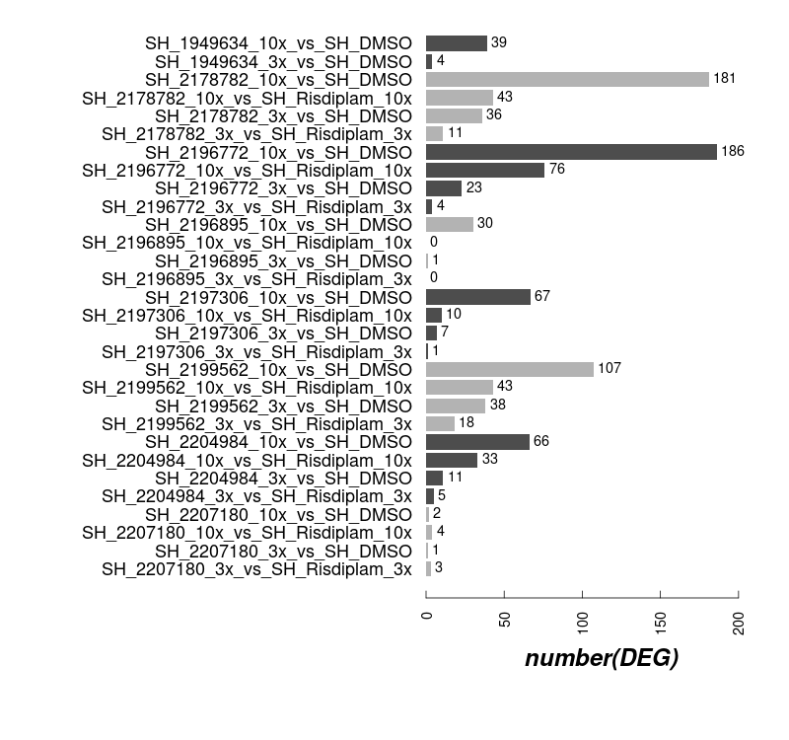
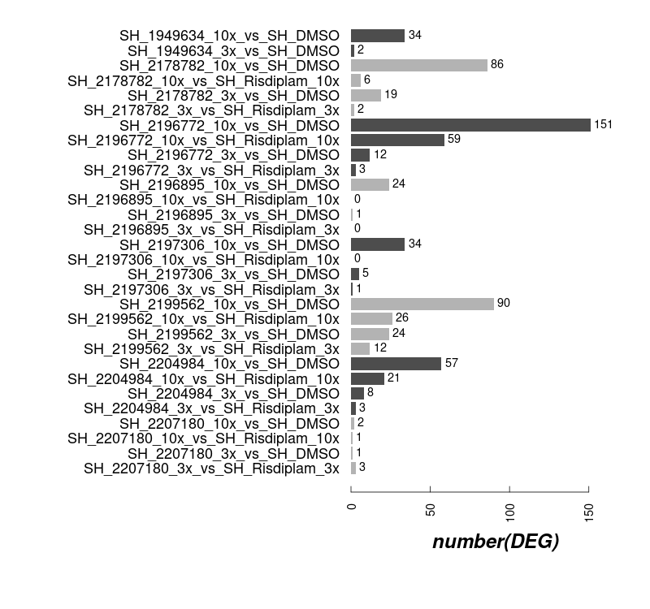
DEG Counts in ShSy5Y off-Targets (7 compounds and risdiplam)
4vs4
3vs3

Slide 10
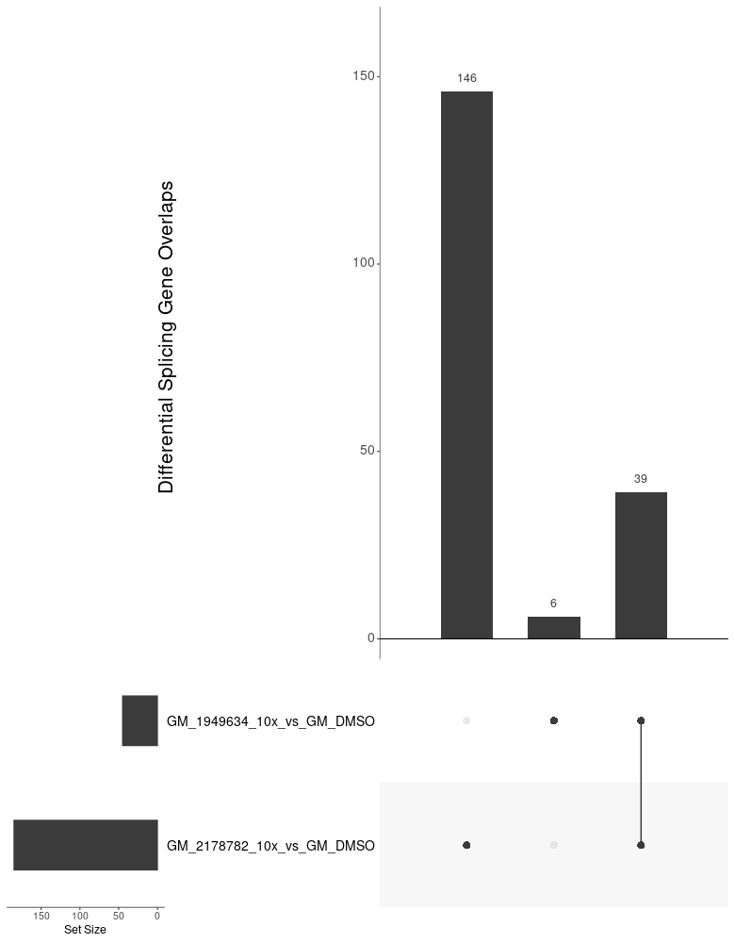
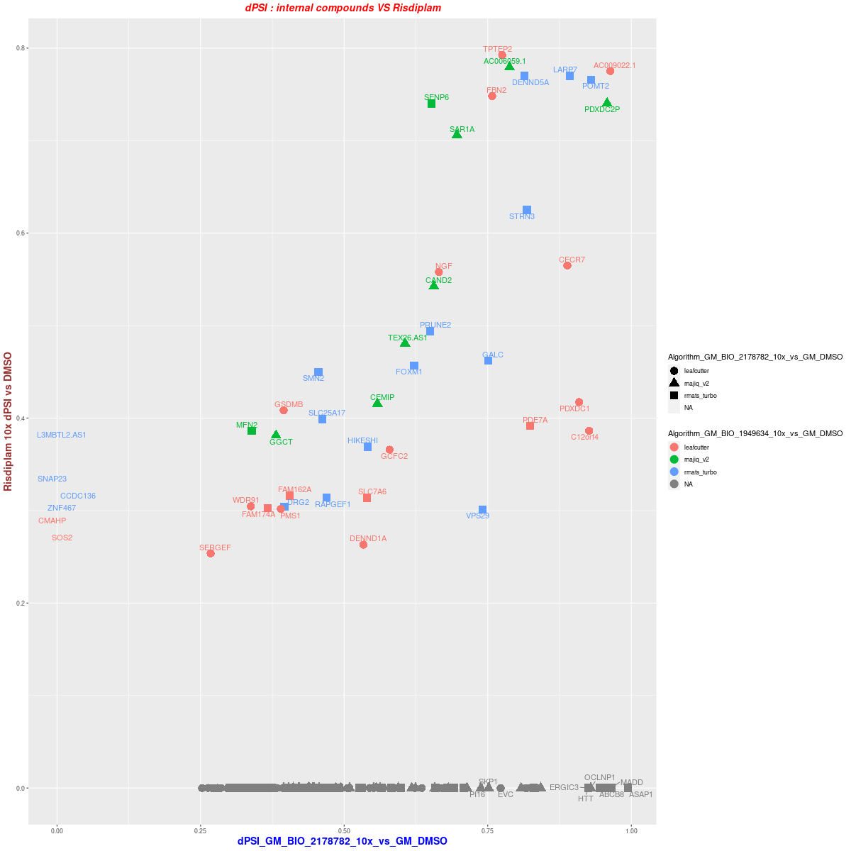
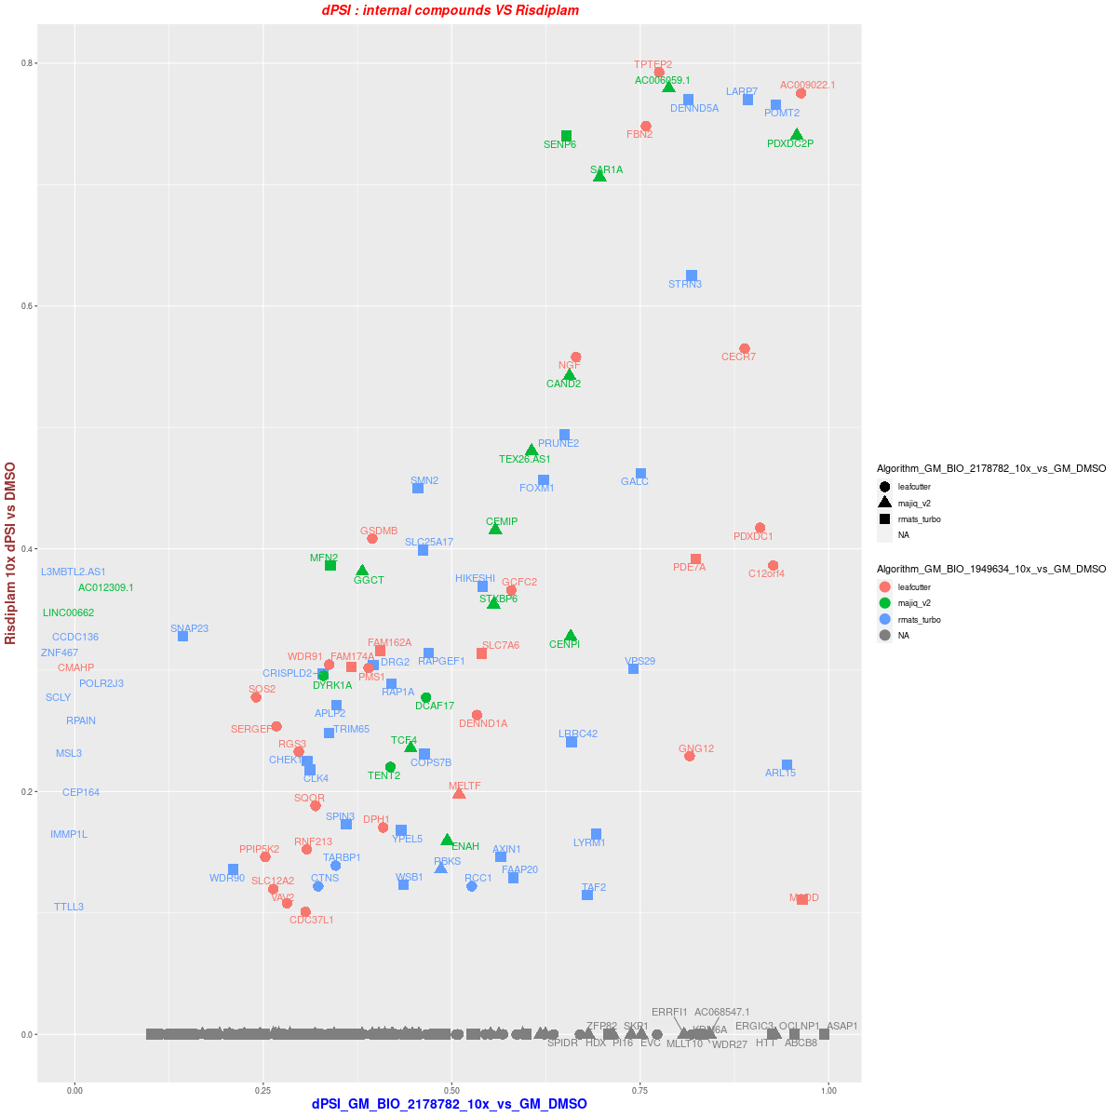
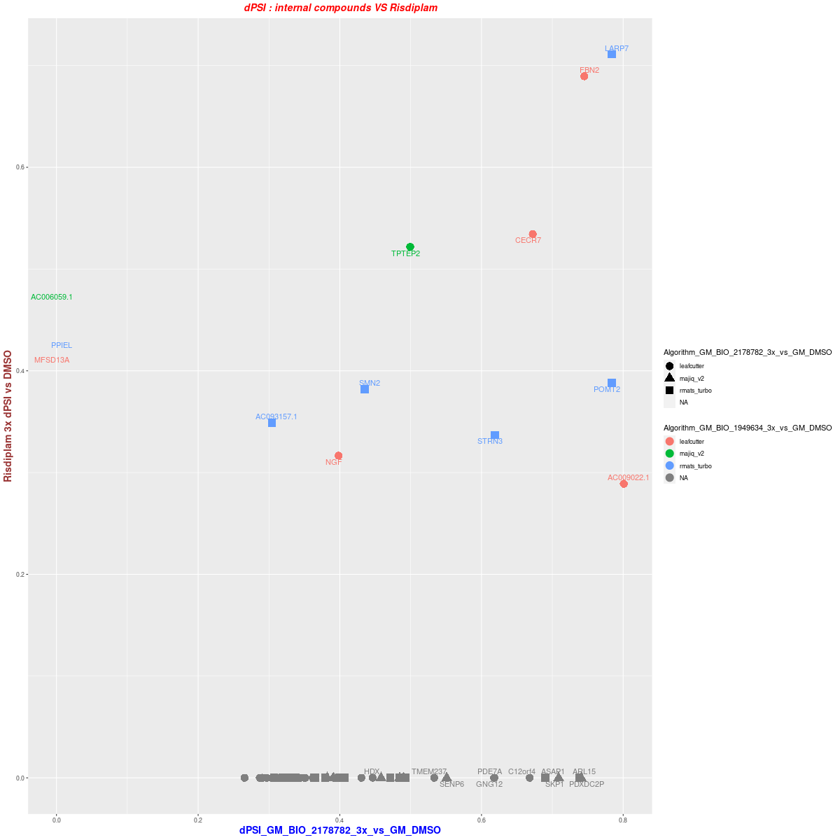
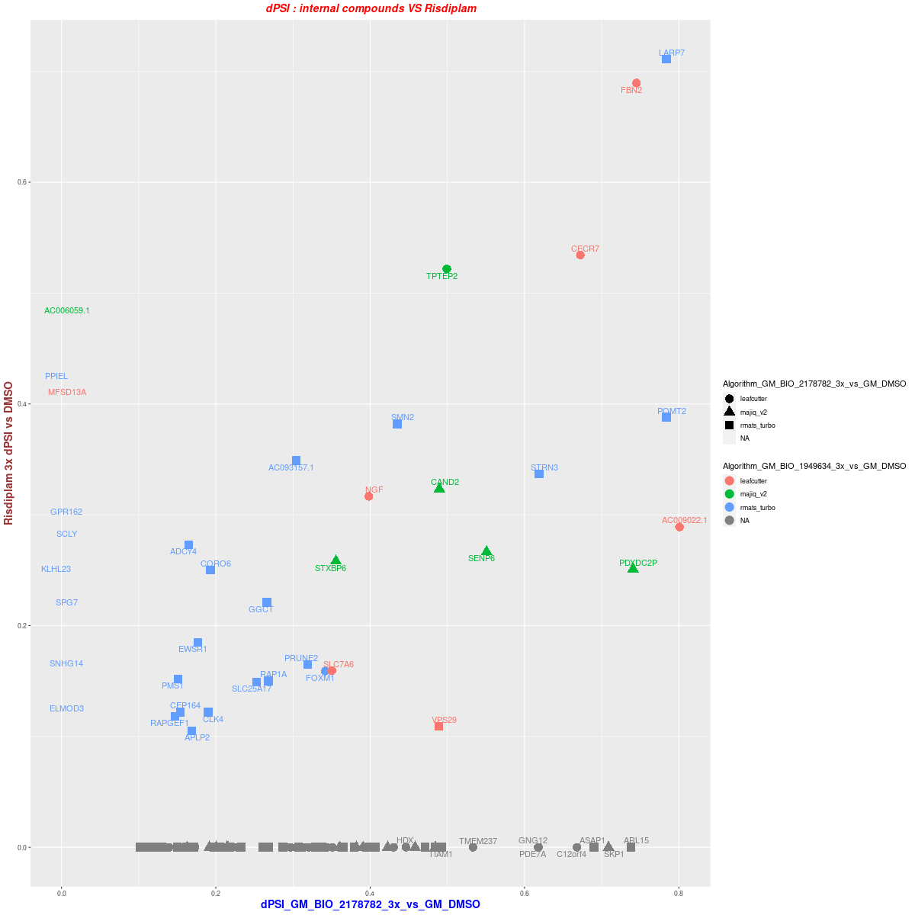


1. GM09677c 3vs3–Dose:10x/3x DSG BIO_2178782 vs Risdiplam
10x
DSG overlap (dPSI >= 0.25)
3x
dPSI distribution ( >= 0.25 in one treatment)
dPSI distribution ( >= 0.1 in one treatment)

Slide 11
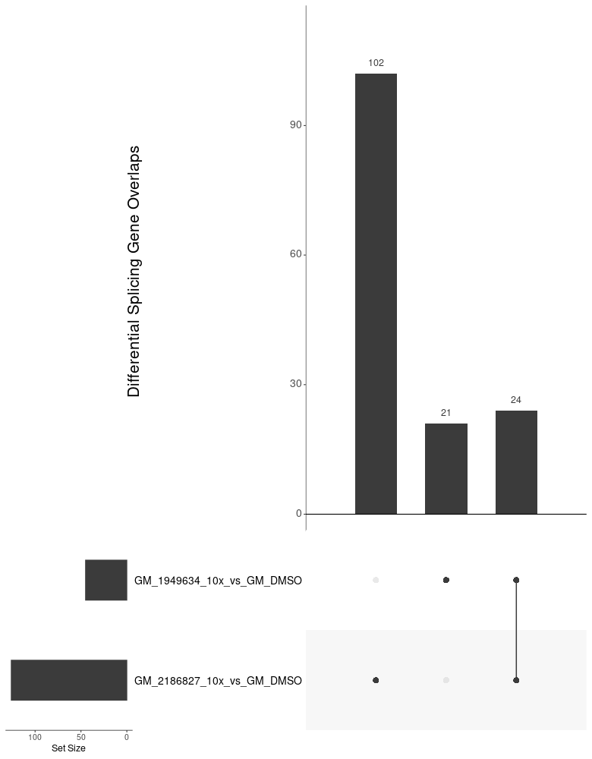
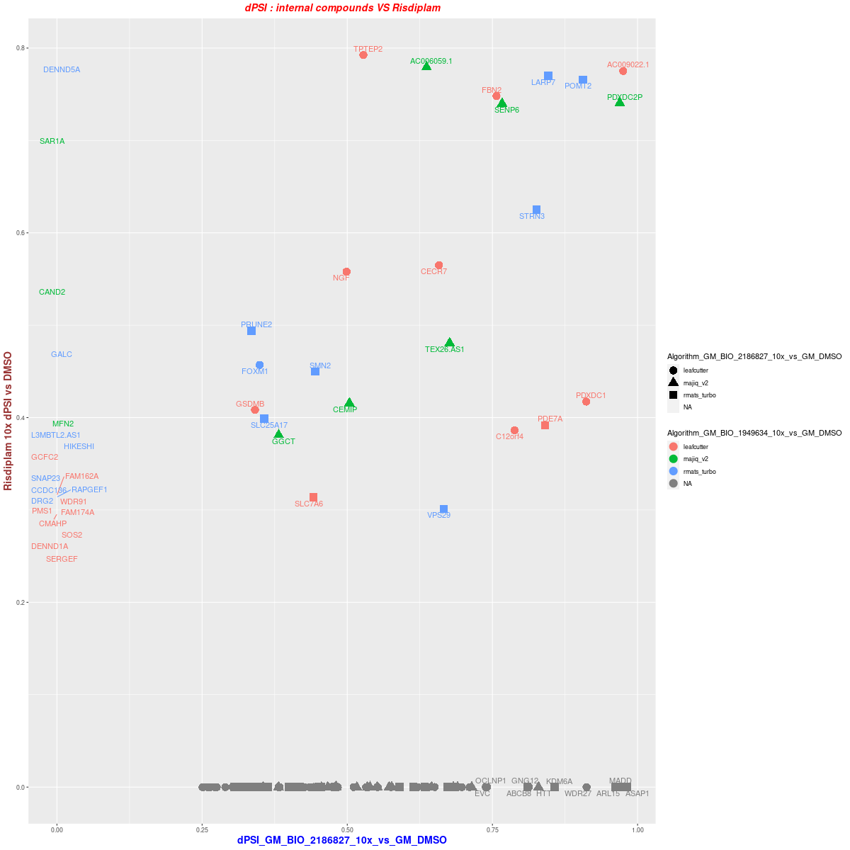
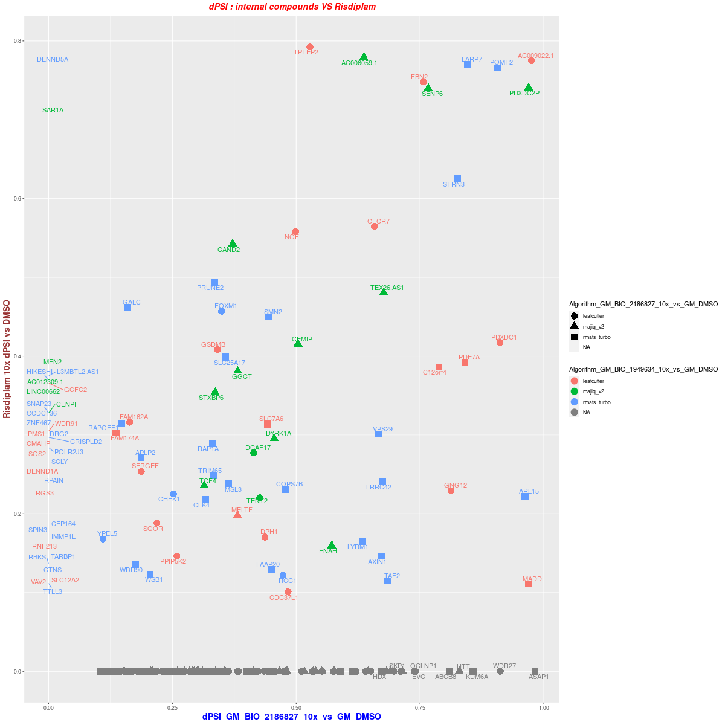
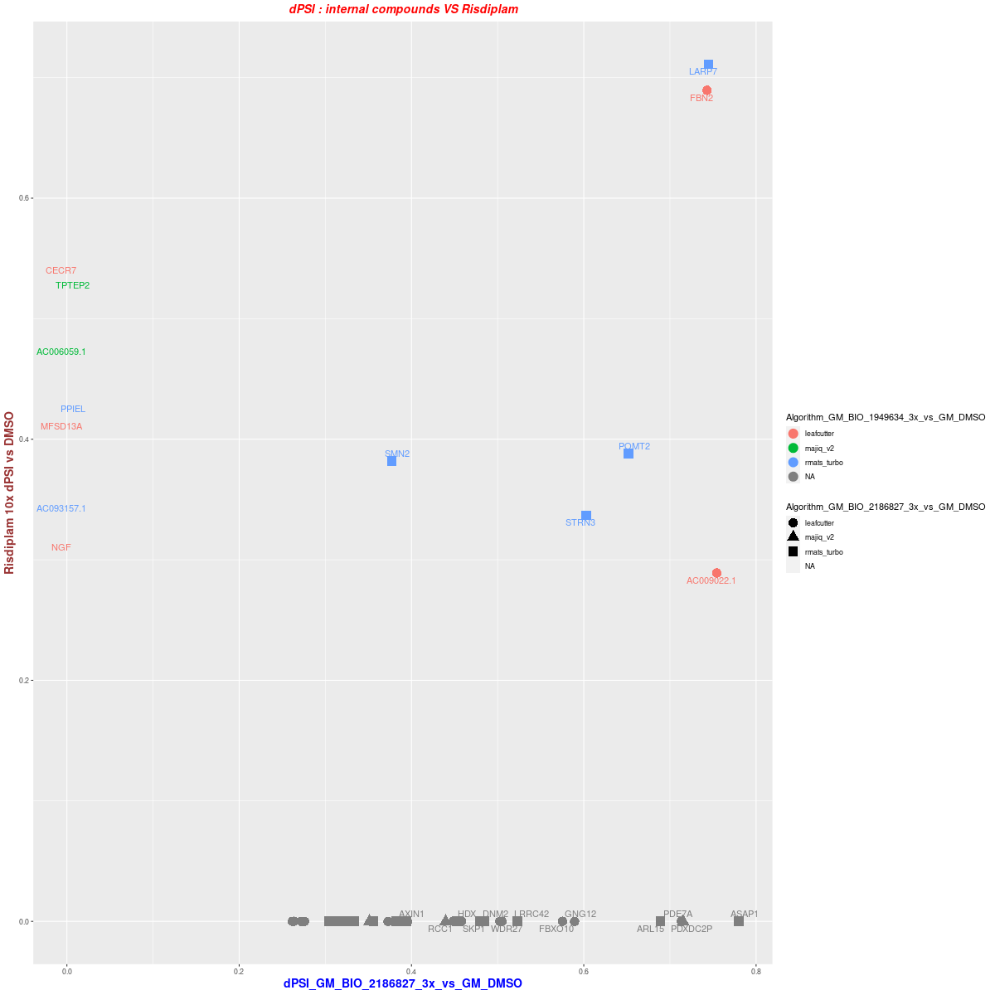
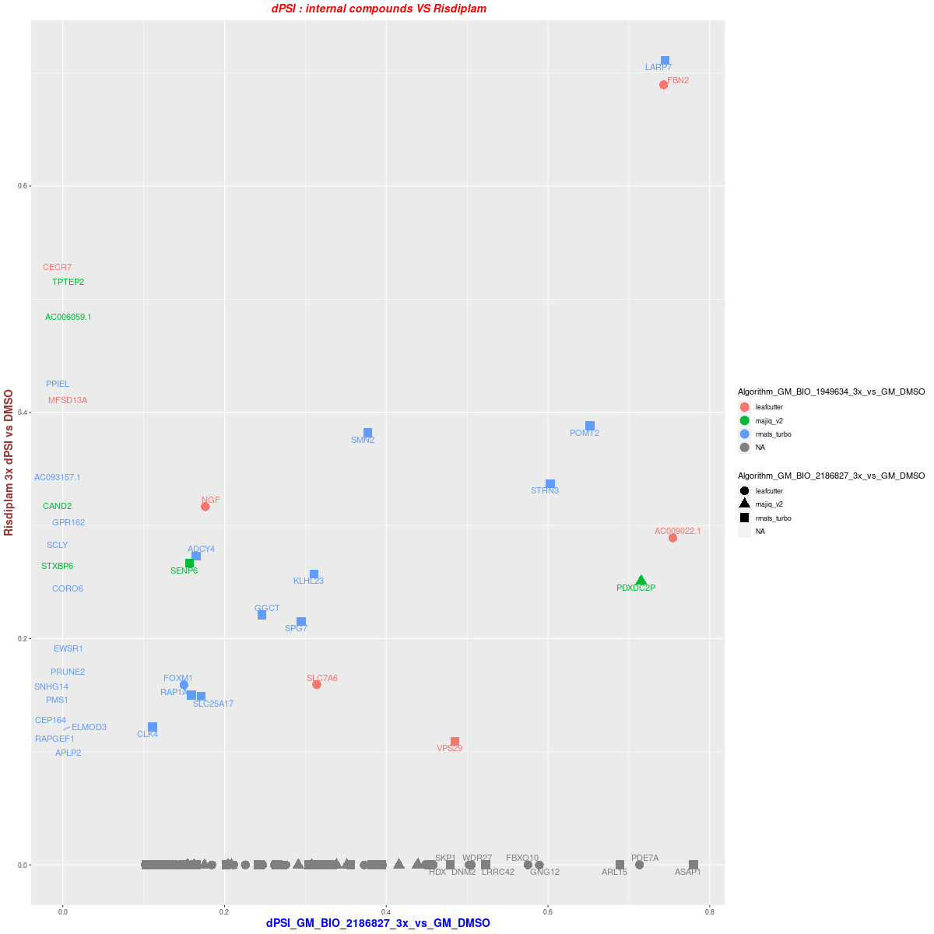

2. GM09677c 3vs3--Dose:10x/3x DSG BIO_2186827 vs Risdiplam
10x
DSG overlap (dPSI >= 0.25)
3x
dPSI distribution ( >= 0.25 in one treatment)
dPSI distribution ( >= 0.1 in one treatment)

Slide 12
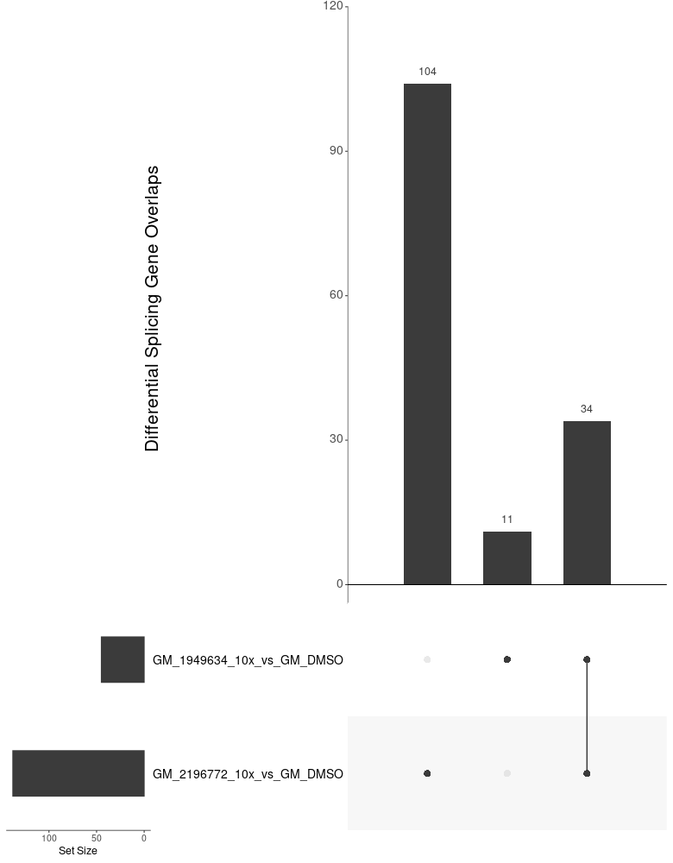
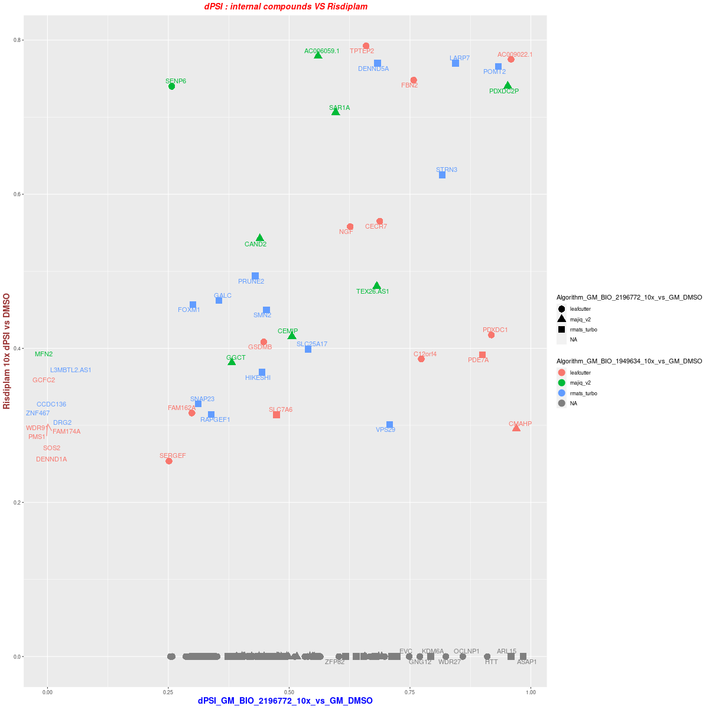
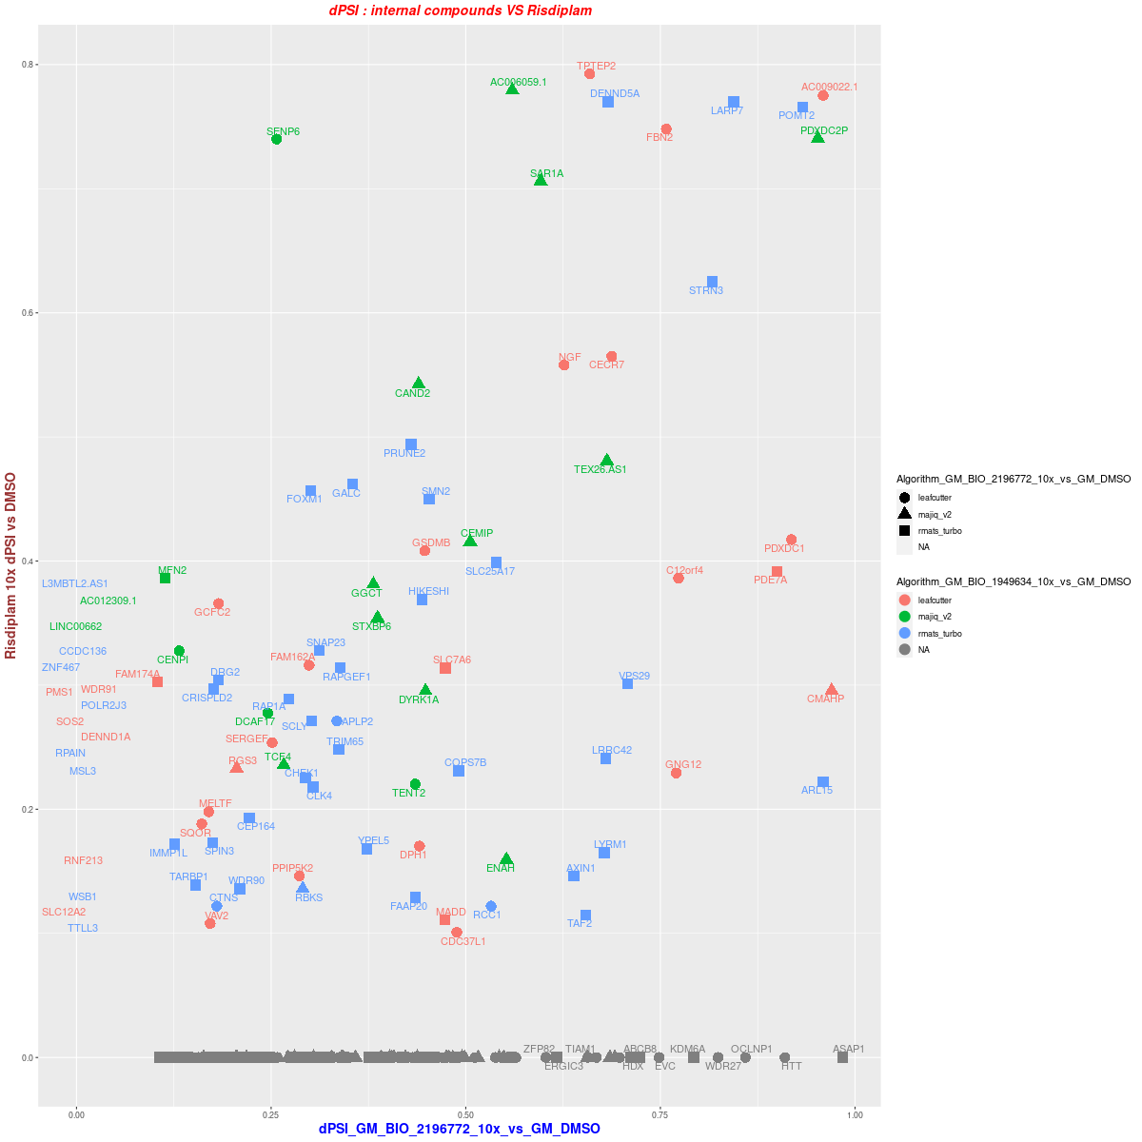
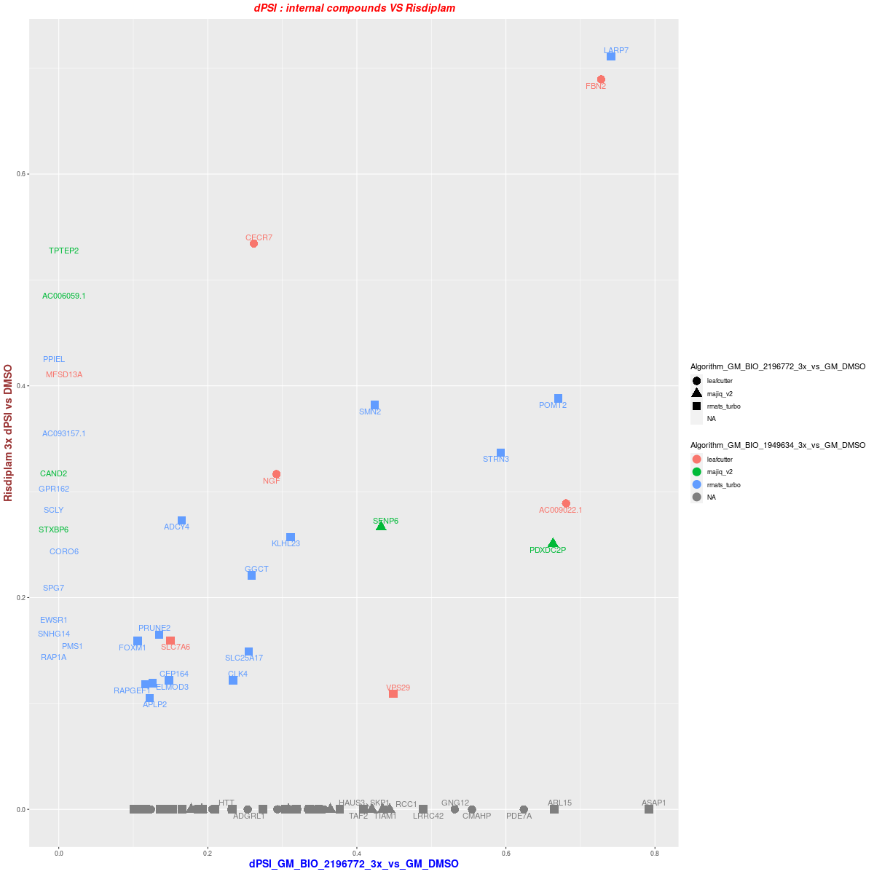
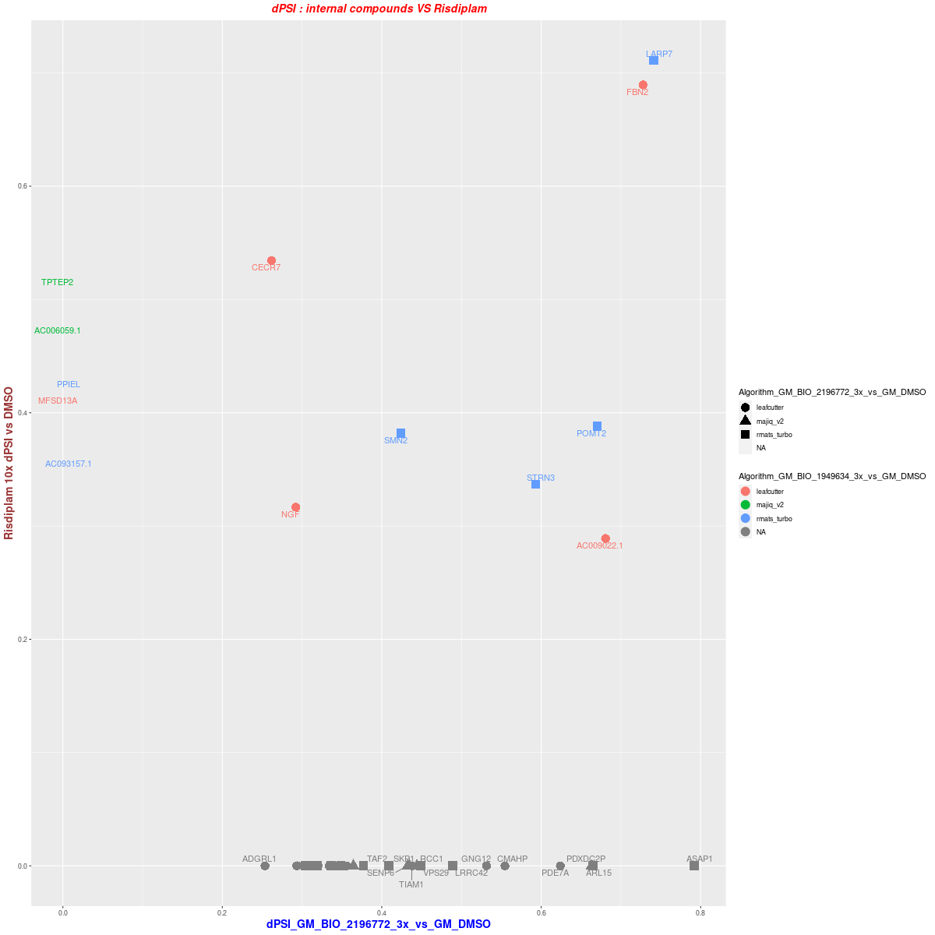
3. GM09677c 3vs3--Dose:10x/3x DSG BIO_2196772 vs Risdiplam
10x
DSG overlap (dPSI >= 0.25)
3x
dPSI distribution ( >= 0.25 in one treatment)
dPSI distribution ( >= 0.1 in one treatment)

Slide 13
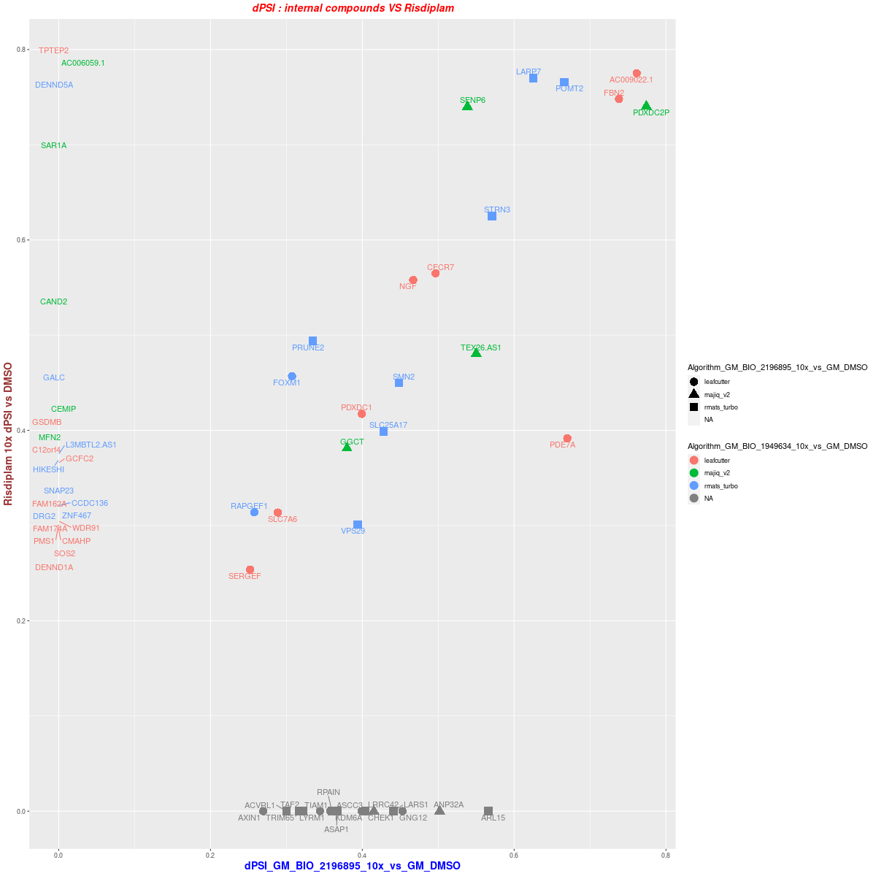
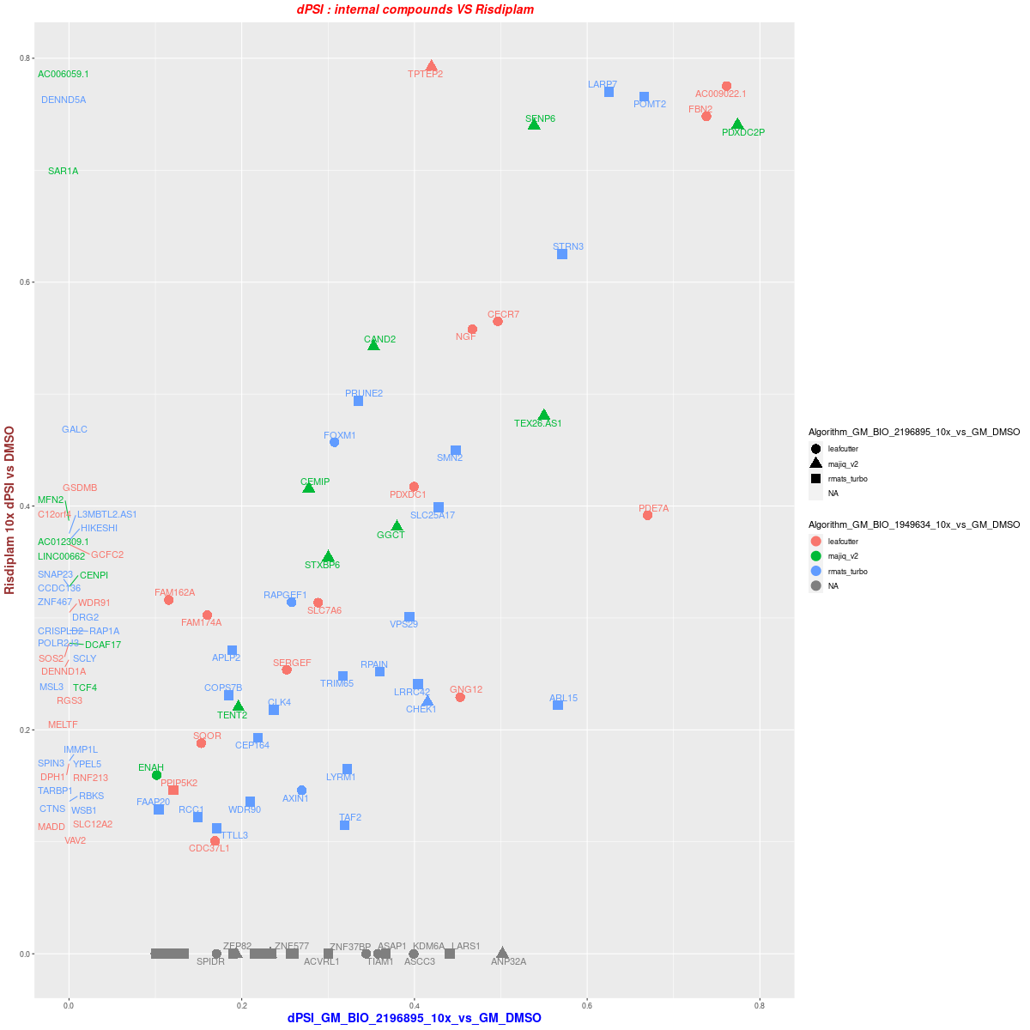
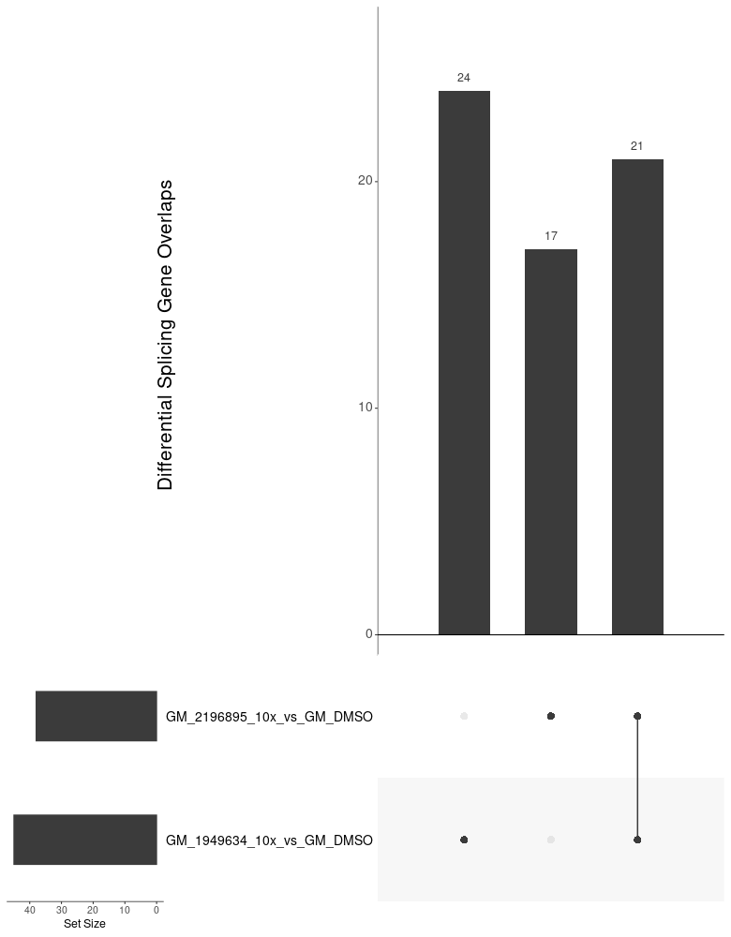
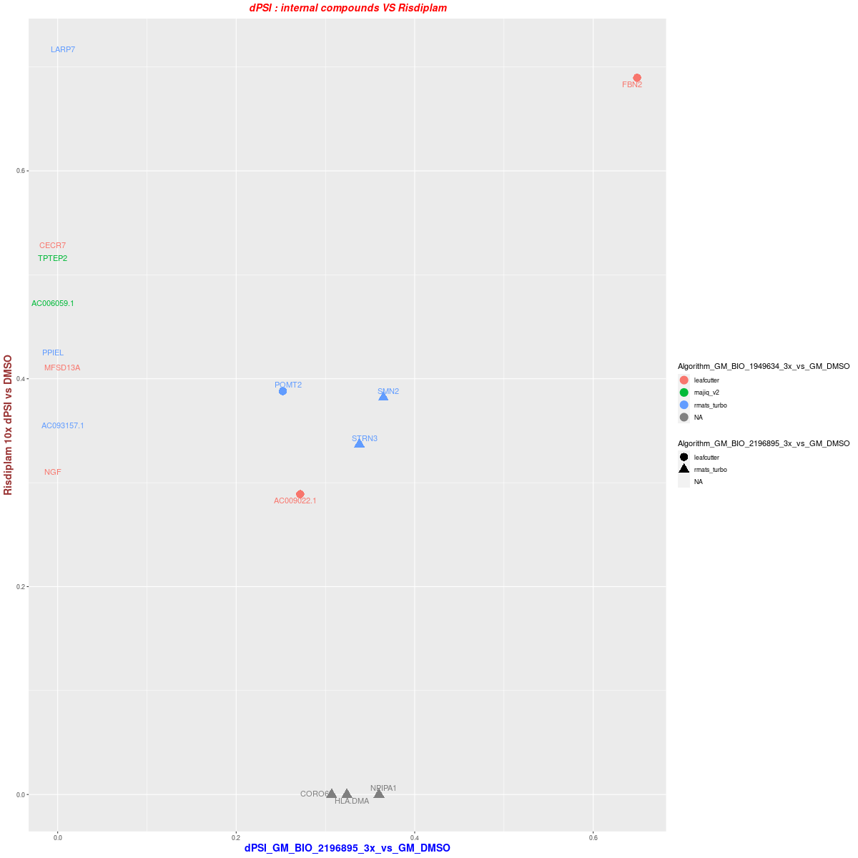
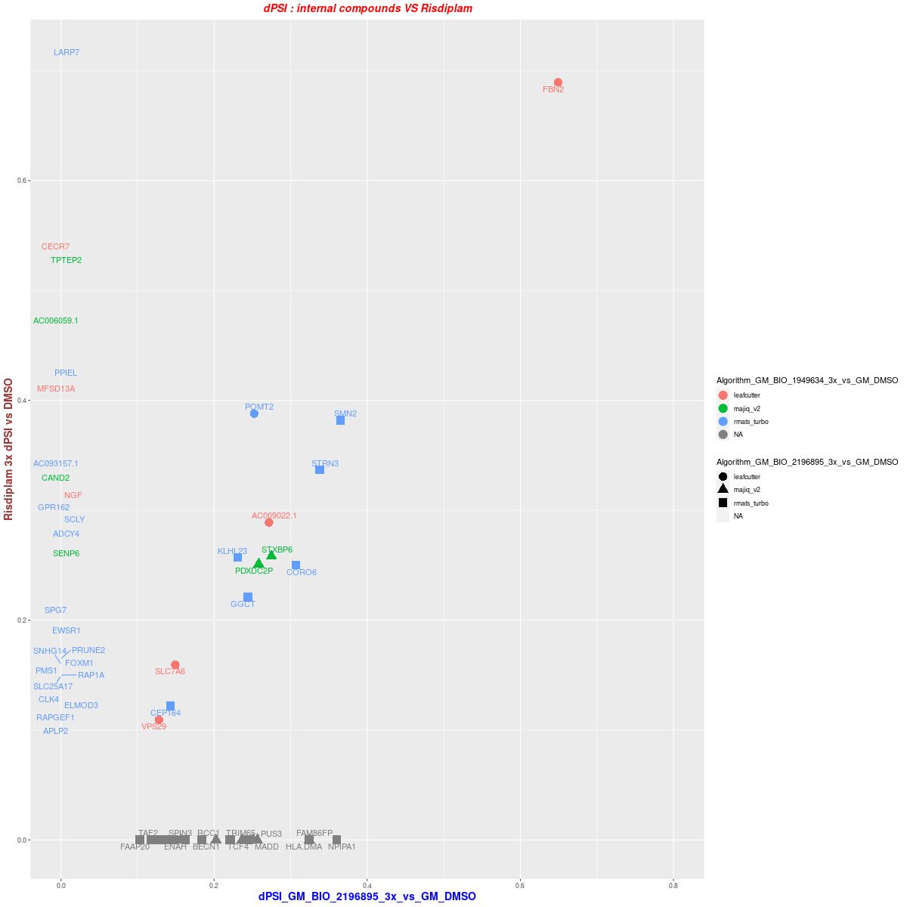
4. GM09677c 3vs3--Dose:10x/3x DSG BIO_2196895 vs Risdiplam
10x
DSG overlap (dPSI >= 0.25)
3x
dPSI distribution ( >= 0.25 in one treatment)
dPSI distribution ( >= 0.1 in one treatment)

Slide 14
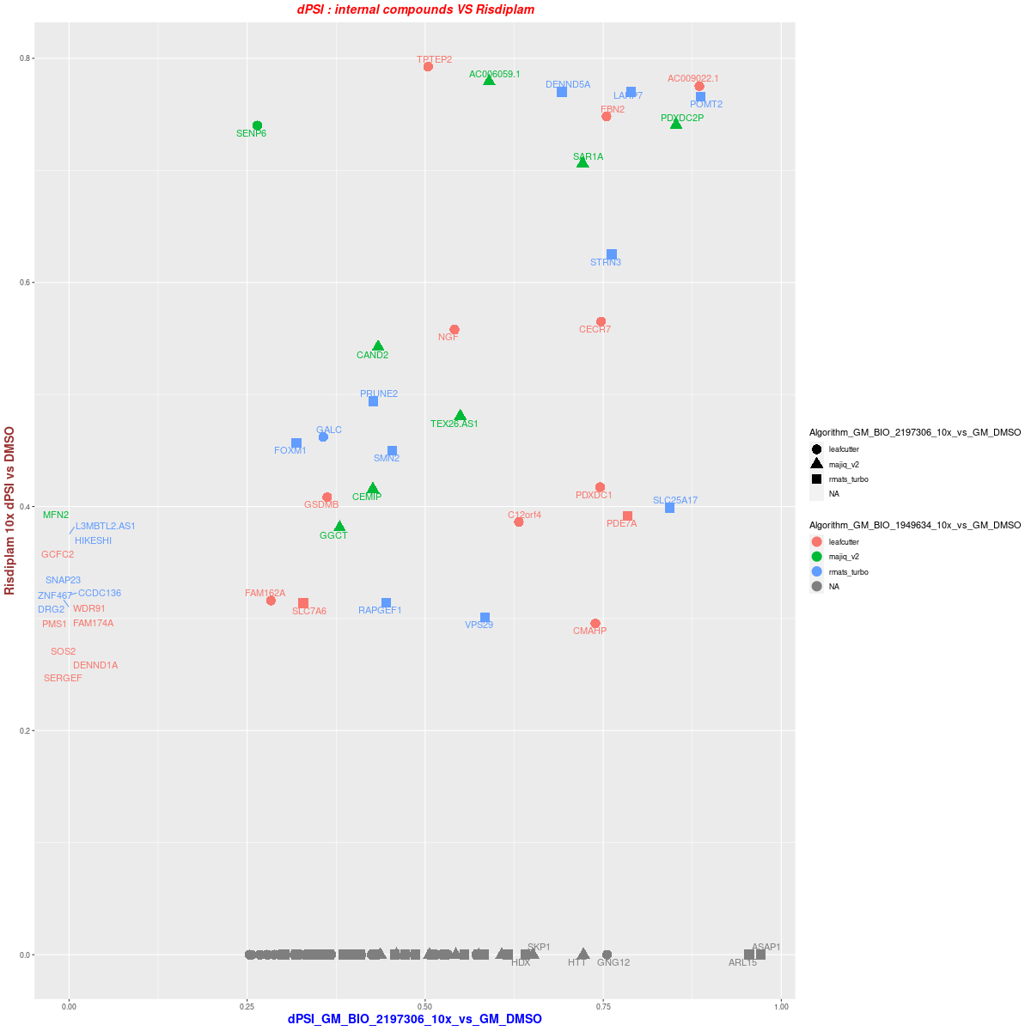
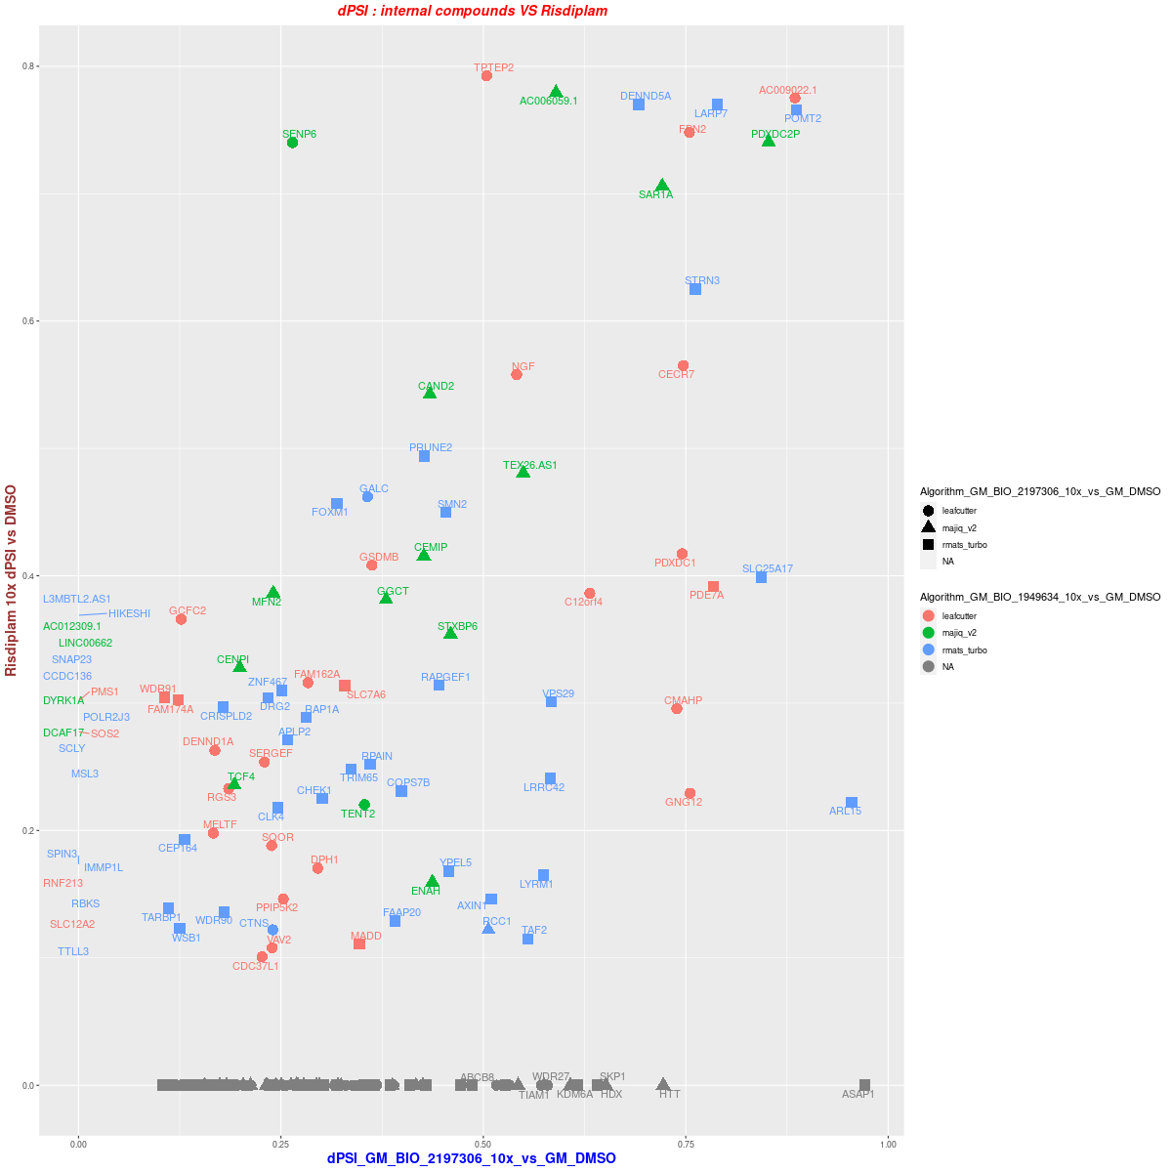
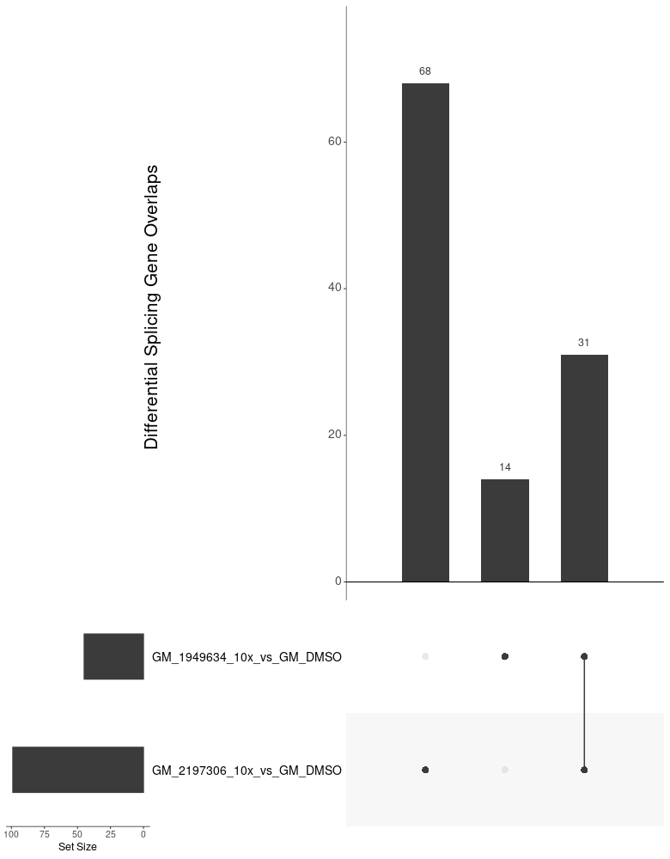
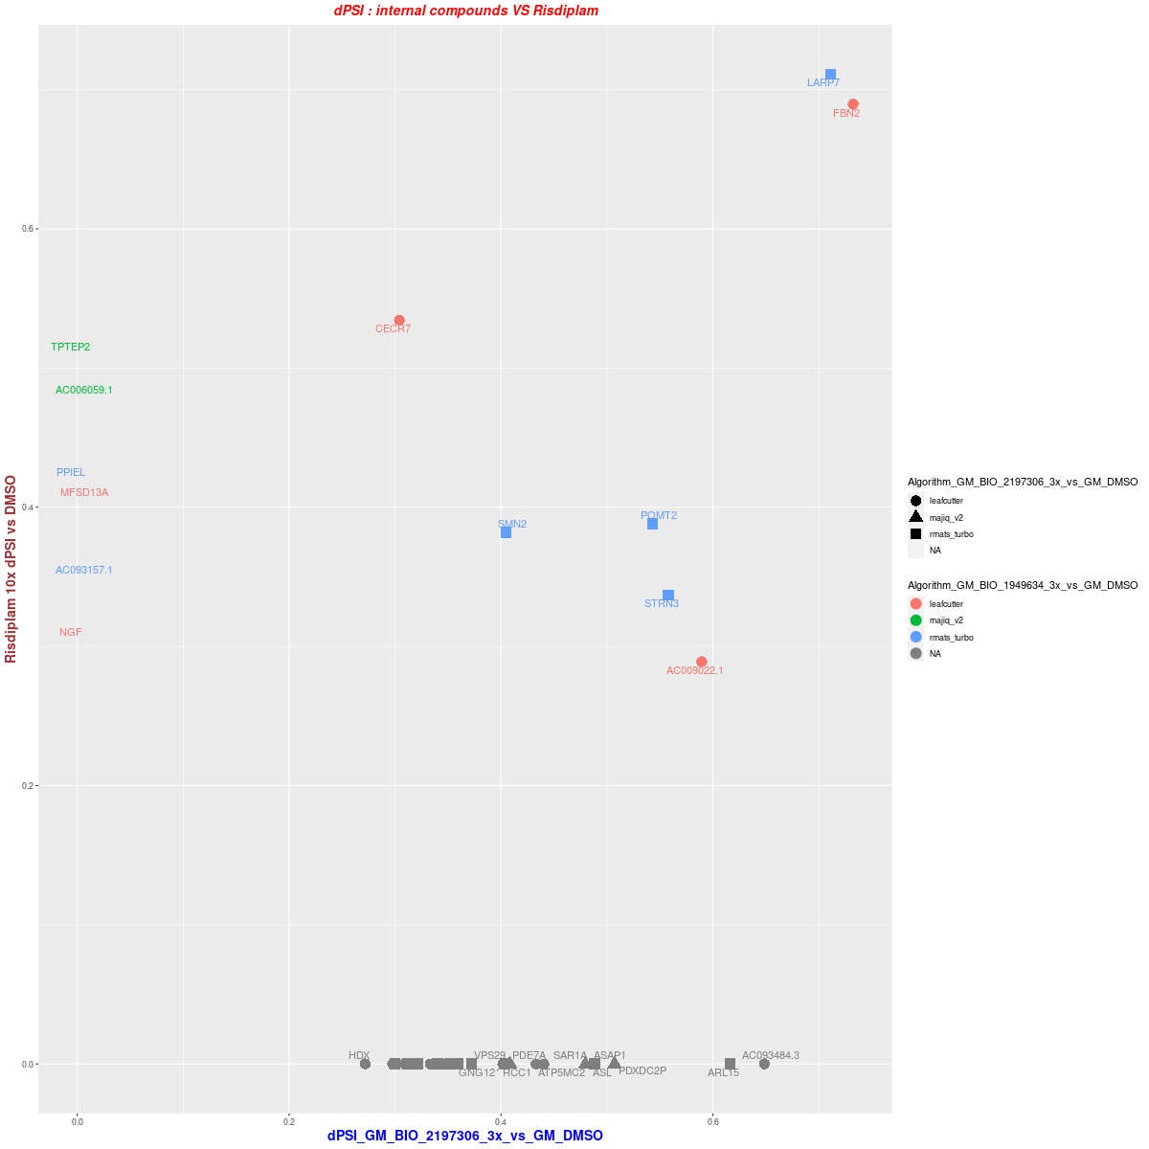
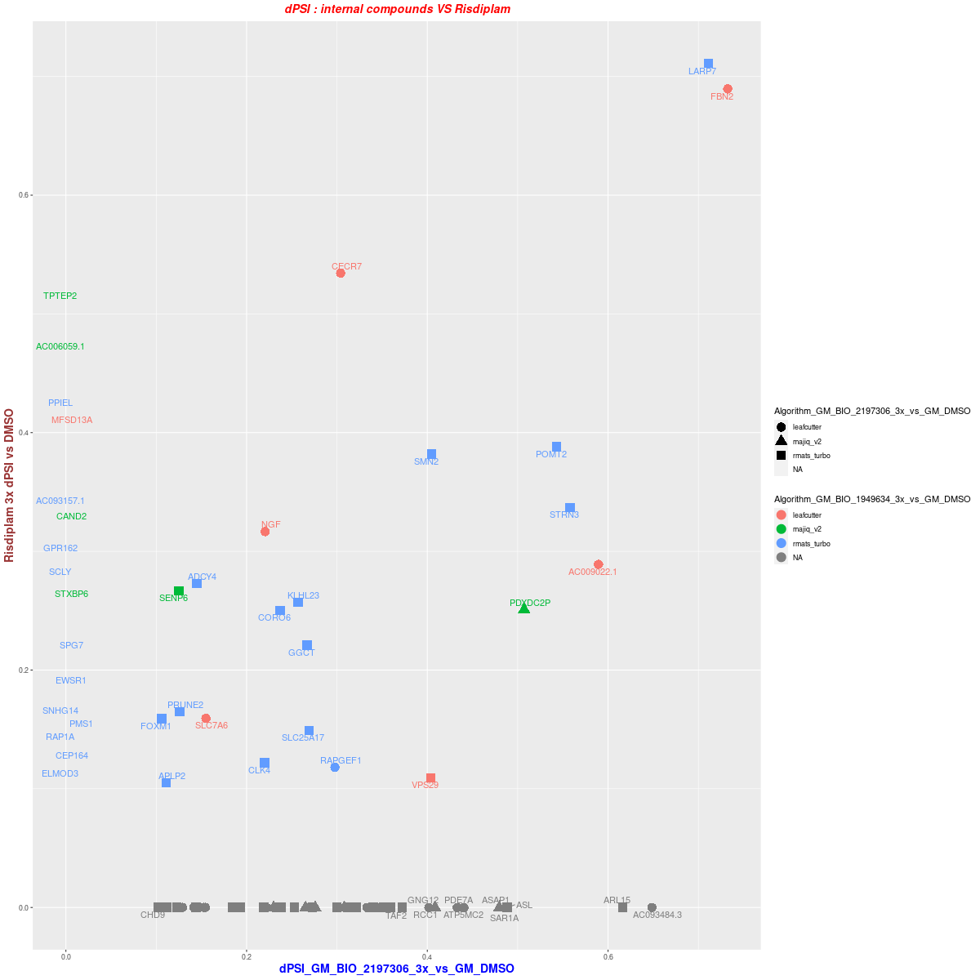
5. GM09677c 3vs3-- Dose:10x/3x DSG BIO_2197306 vs Risdiplam
10x
DSG overlap (dPSI >= 0.25)
3x
dPSI distribution ( >= 0.25 in one treatment)
dPSI distribution ( >= 0.1 in one treatment)

Slide 15
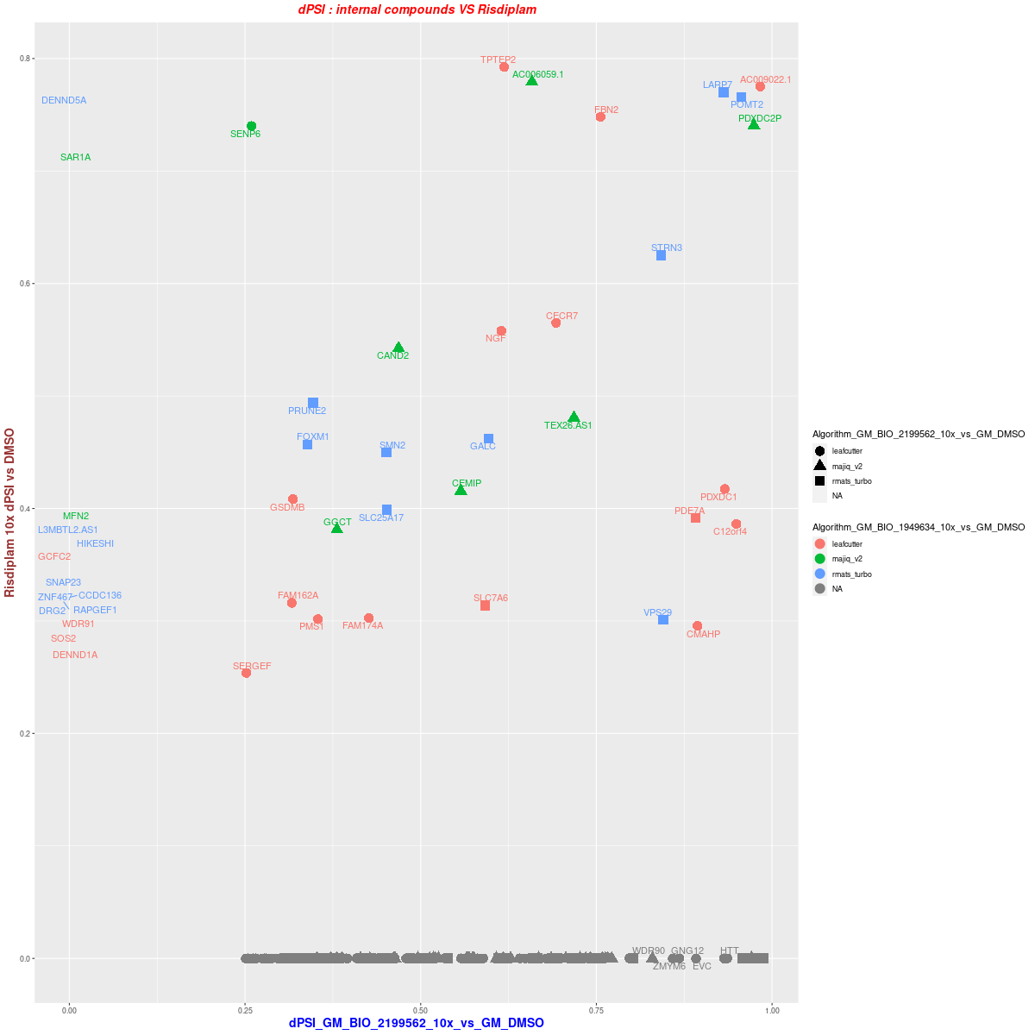
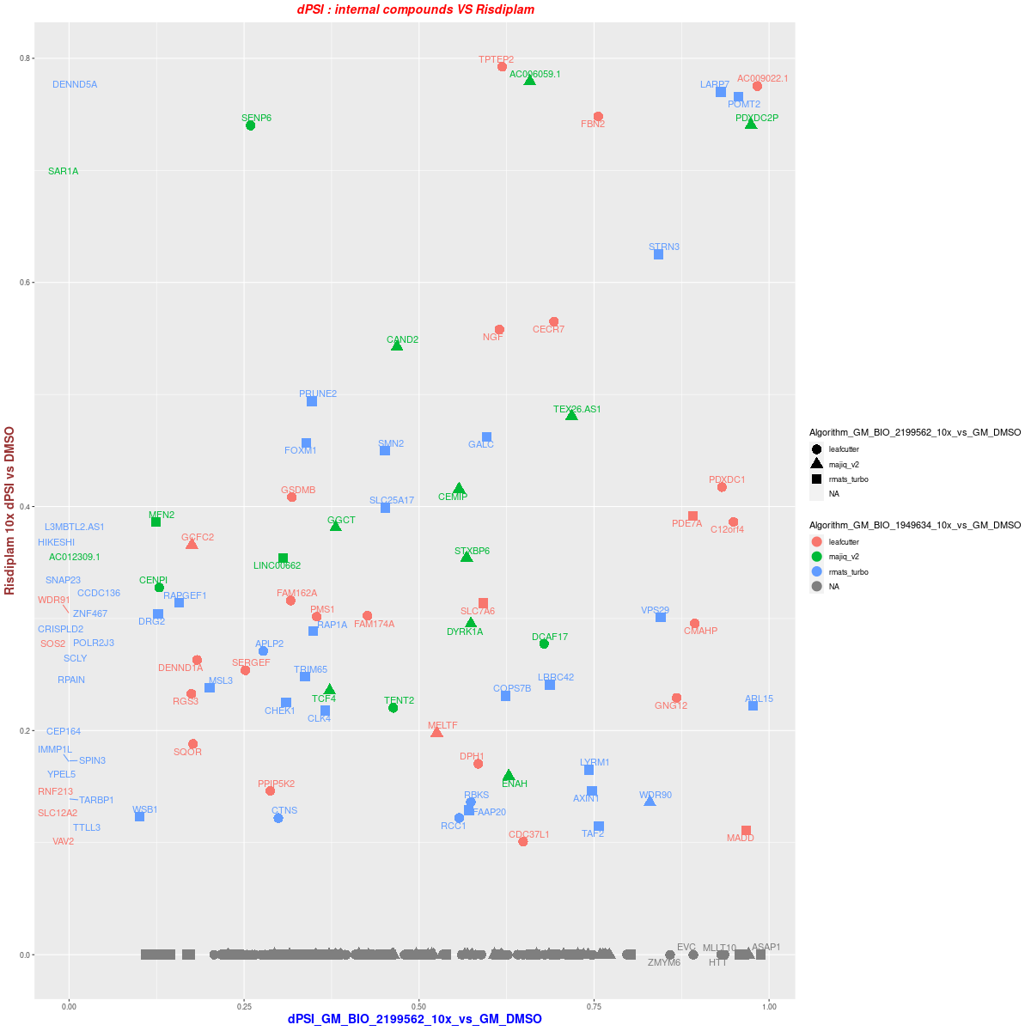



6. GM09677c 3vs3--Dose:10x/3x DSG BIO_2199562 vs Risdiplam
10x
DSG overlap (dPSI >= 0.25)
3x
dPSI distribution ( >= 0.25 in one treatment)
dPSI distribution ( >= 0.1 in one treatment)

Slide 16





7. GM09677c 3vs3--Dose:10x/3x DSG BIO_2201042 vs Risdiplam
10x
DSG overlap (dPSI >= 0.25)
3x
dPSI distribution ( >= 0.25 in one treatment)
dPSI distribution ( >= 0.1 in one treatment)

Slide 17





8. GM09677c 3vs3-- Dose:10x/3x DSG BIO_2204984 vs Risdiplam
10x
DSG overlap (dPSI >= 0.25)
3x
dPSI distribution ( >= 0.25 in one treatment)
dPSI distribution ( >= 0.1 in one treatment)

Slide 18





9. GM09677c 3vs3-- Dose:10x/3x DSG BIO_2206678 vs Risdiplam
10x
DSG overlap (dPSI >= 0.25)
3x
dPSI distribution ( >= 0.25 in one treatment)
dPSI distribution ( >= 0.1 in one treatment)

Slide 19





10. GM09677c 3vs3--Dose:10x/3x DSG BIO_2207180 vs Risdiplam
10x
DSG overlap (dPSI >= 0.25)
3x
dPSI distribution ( >= 0.25 in one treatment)
dPSI distribution ( >= 0.1 in one treatment)

Slide 20



1. GM09677c 3vs3-- Dose:10x/3x DEG BIO_2178782 vs Risdiplam
10x
3x

Slide 21



2. GM09677c 3vs3-- Dose:10x/3x DEG BIO_2186827 vs Risdiplam
10x
3x
dPSI distribution ( >= 0.25 in one treatment)

Slide 22



3. GM09677c 3vs3-- Dose:10x/3x DEG BIO_2196772 vs Risdiplam
10x
3x

Slide 23



4. GM09677c 3vs3-- Dose:10x/3x DEG BIO_2196895 vs Risdiplam
10x
3x

Slide 24



5. GM09677c 3vs3-- Dose:10x/3x DEG BIO_2197306 vs Risdiplam
10x
3x

Slide 25



6. GM09677c 3vs3-- Dose:10x/3x DEG BIO_2199562 vs Risdiplam
10x
3x

Slide 26



7. GM09677c 3vs3-- Dose:10x/3x DEG BIO_2201042 vs Risdiplam
10x
3x

Slide 27



8. GM09677c 3vs3-- Dose:10x/3x DEG BIO_2204984 vs Risdiplam
10x
3x

Slide 28



9. GM09677c 3vs3-- Dose:10x/3x DEG BIO_2206678 vs Risdiplam
10x
3x

Slide 29



10. GM09677c 3vs3--Dose:10x/3x DEG BIO_2207180 vs Risdiplam
10x
3x

Slide 30
Thank you, everyone in RDS and Genomics science!

Slide 31
http://compbio.biogen.com:3838/Quickomics/?testfile=TST12188_ShSy5Y
http://compbio.biogen.com:3838/Quickomics/?testfile=TST12188_GM_Ris
http://compbio.biogen.com:3838/Quickomics/?testfile=TST12188_GM09677c_3vs3
http://compbio.biogen.com:3838/Quickomics/?testfile=TST12188_Sh_GR38_3vs3

